Slide 1
28 – aorta 25 lung 12 ventricle 13 vena cava 9 atrium 6 penis 7 testicle 8 epididimus

Slide 2
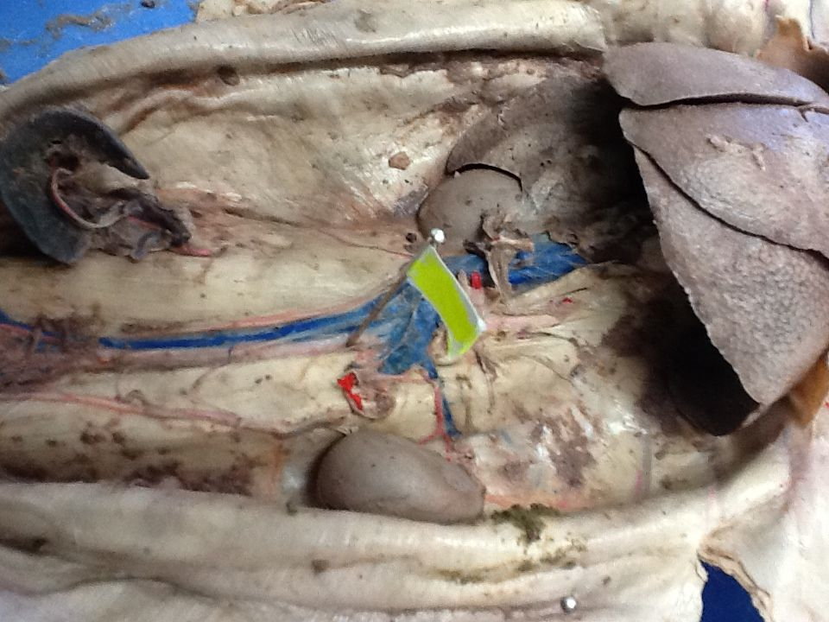
28
28

Slide 3
25

Slide 4
12

Slide 5
13

Slide 6
9

Slide 7
6

Slide 8
7

Slide 9
8

