Slide 1
24 Liver
1 Trachea
27 dorsal
18 rectum

Slide 2
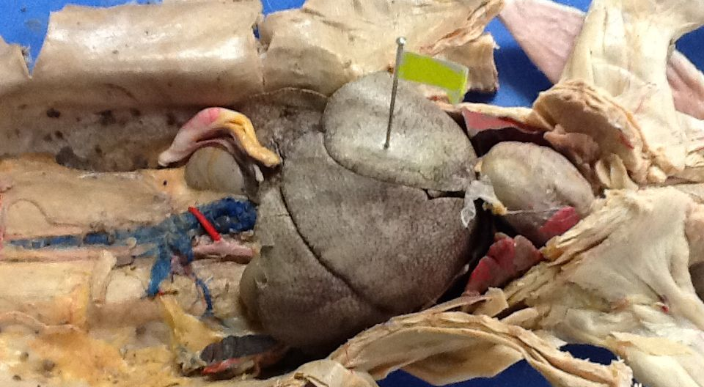
24

Slide 3
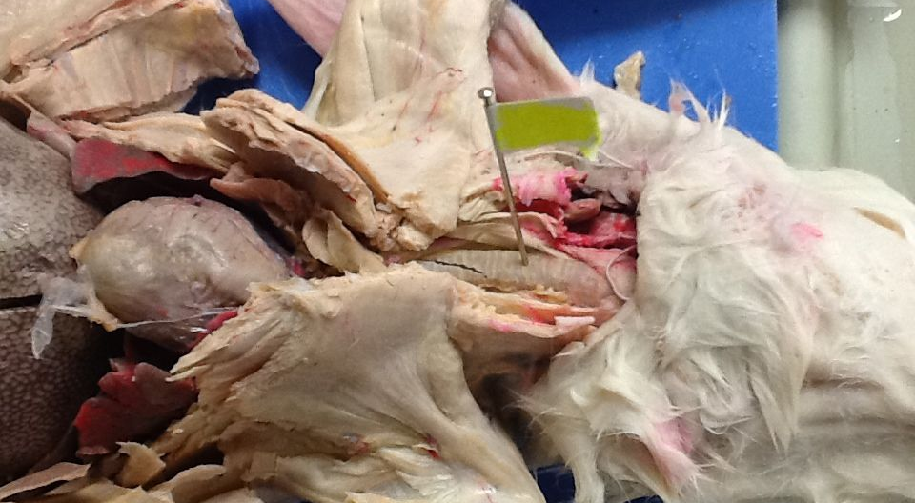
1

Slide 4
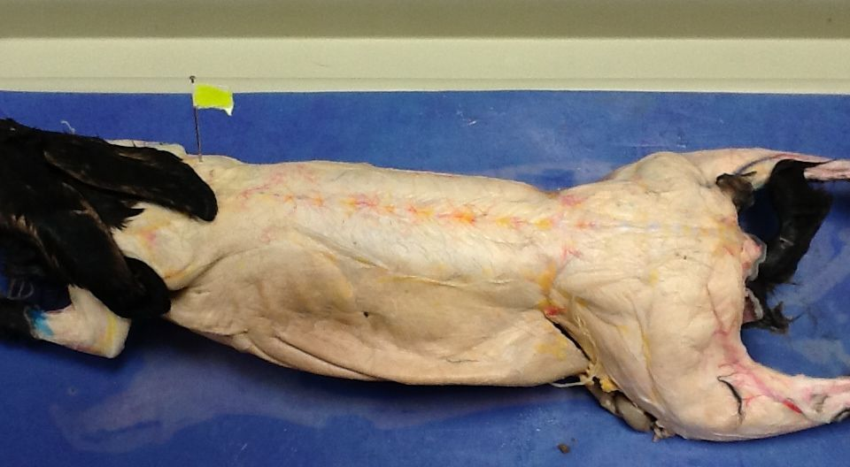
27

Slide 5
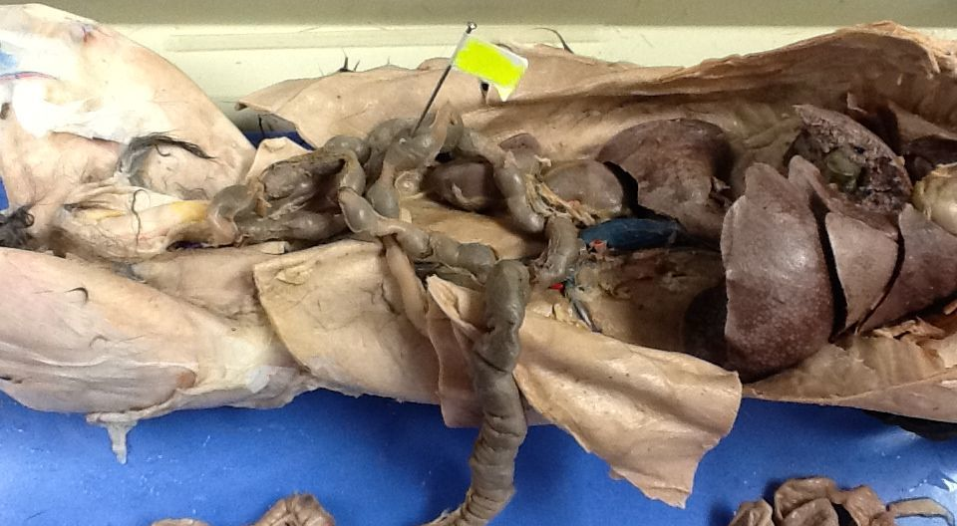
18 – notice there is poop in it

