Slide 1
5 Bladder
10 ureter
15 fat
23 renal artery
22 spleen
4 kidney
14 anus
17 renal vein
11 cecum

Slide 2
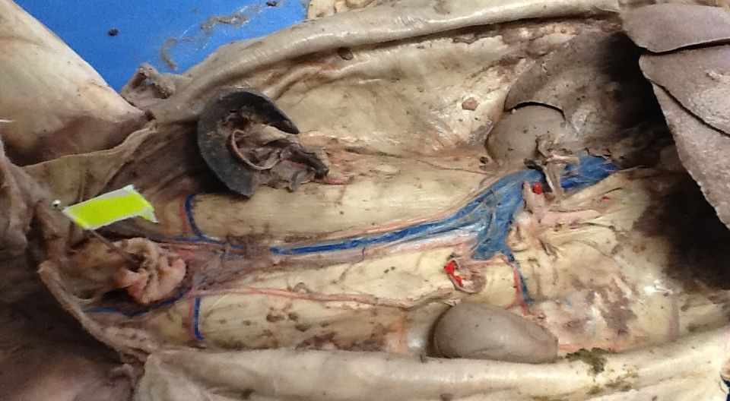
5

Slide 3
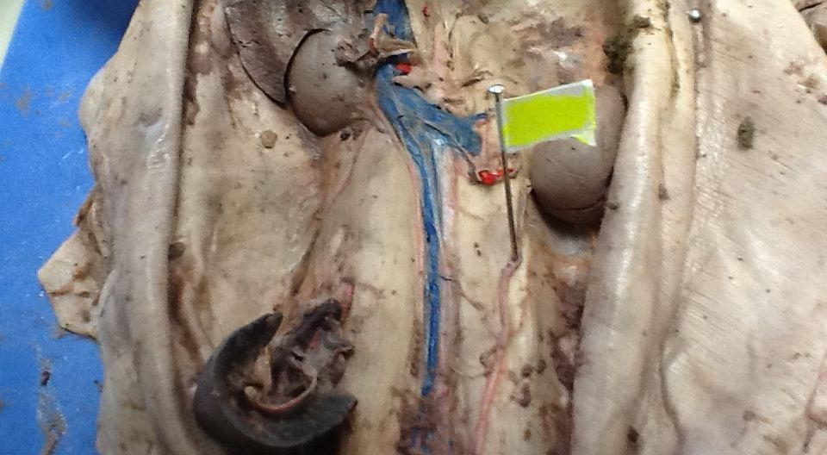
10

Slide 4
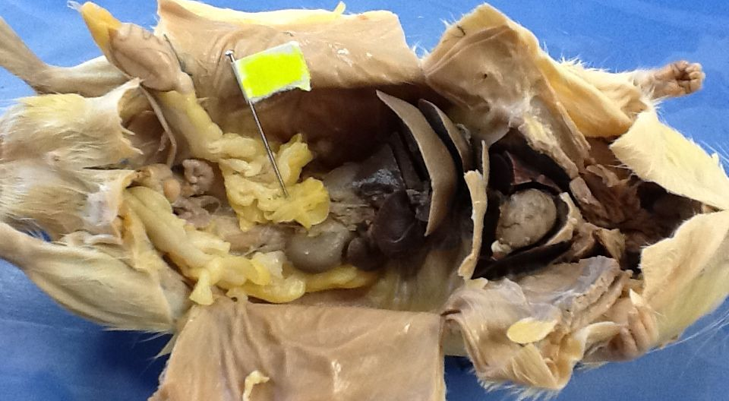
15

Slide 5
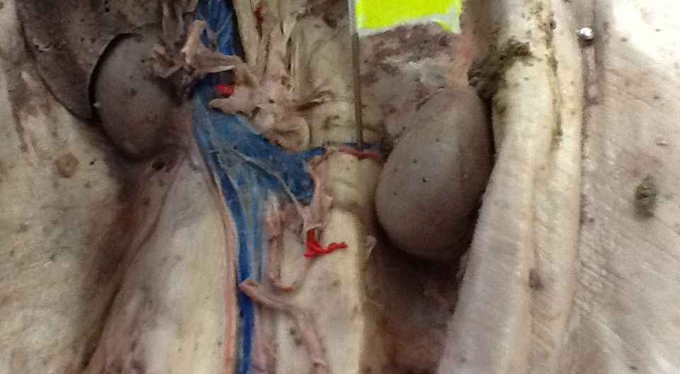
23-red

Slide 6
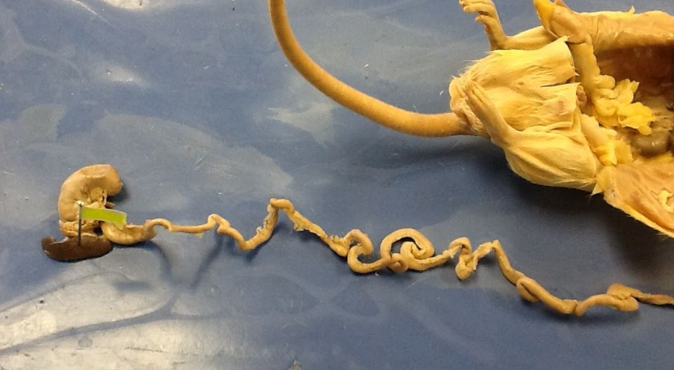
22

Slide 7
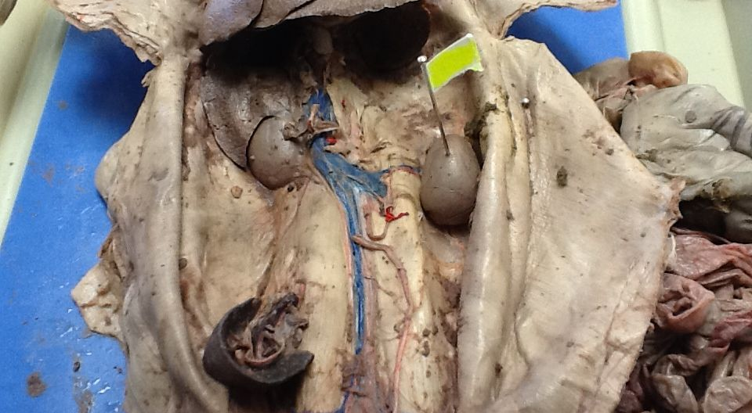
4

Slide 8
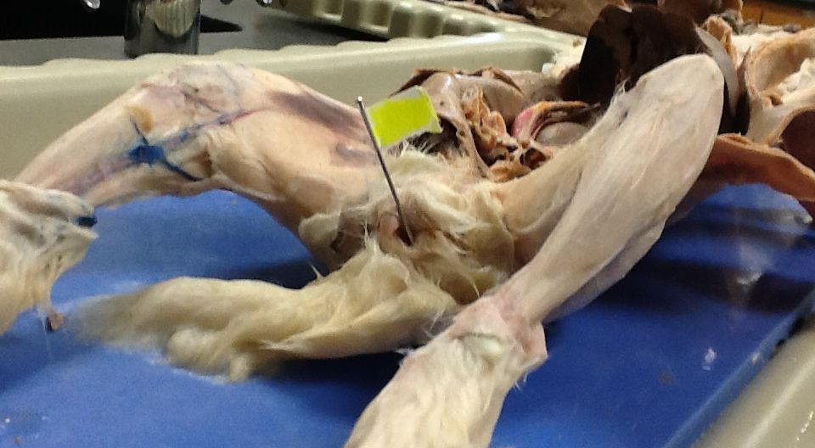
14

Slide 9
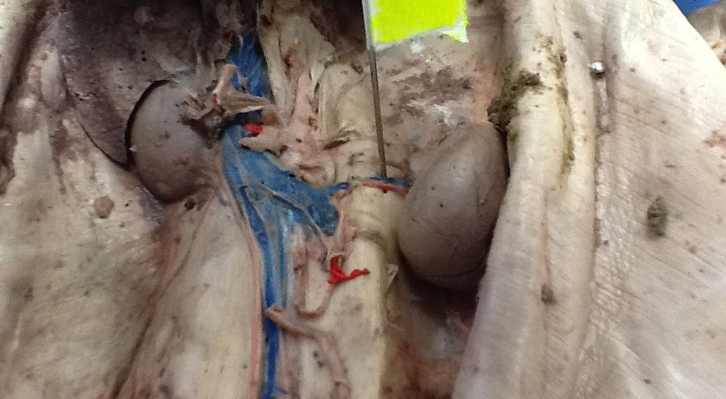
17 – blue

Slide 10
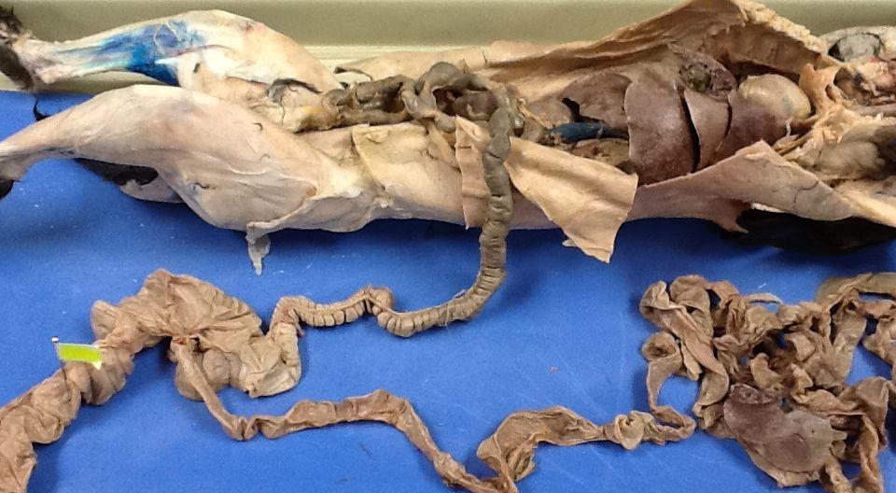
11

