Slide 1
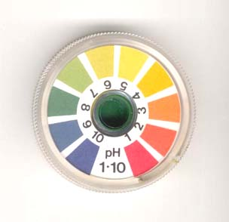
Acids and Bases
Ch 23

Slide 2
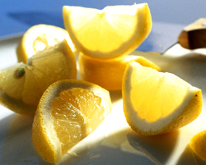
Acids – Make Hydronium ions when added to water.
H₃O+
Properties
when acid added to water, makes H3O (hydronium ions
taste sour
pH less than 7
Electrolytes b/c in solution they contain ions
Are corrosive and can cause severe burns
Reacts with indicators to produce a change in color 9litmus turns red)
Neutralizes bases to form a salt and water

Slide 3
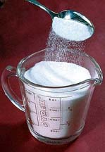
Demo
Sulfuric acid + sugar → carbon + water
Pg 697

Slide 4
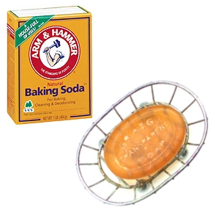
Bases – forms hydroxide ions (OH-) in a water solution.
Properties
Feel slippery
Have a bitter taste
Have a pH of greater than 7
Are electrolytes b/c in solution they contain ions
Are corrosive and can cause severe burns
Reacts with indicators to produce a change in color (litmus turns blue)
Neutralize acids to form a salt and water

Slide 5
Common Bases and their uses
Pg 699

Slide 6
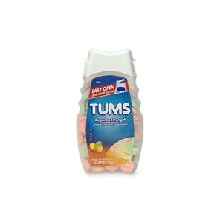
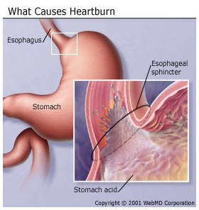
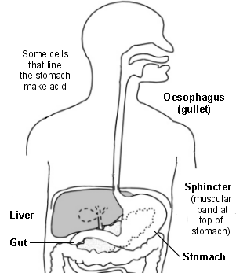
Mini Lab on page 698

Slide 7
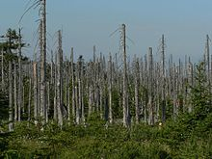
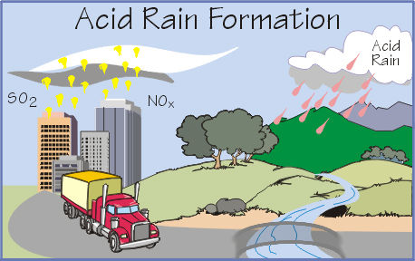
Acid rain – pH 5.7

Slide 8
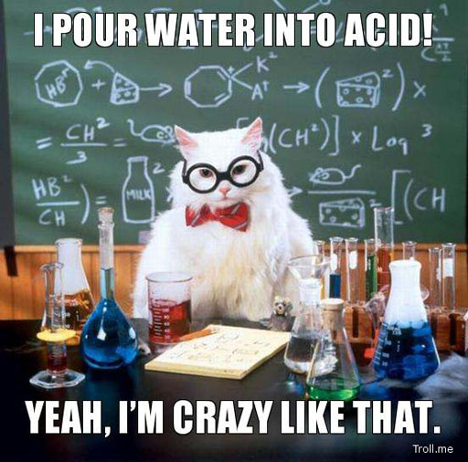

Slide 9
Strength vs. Concentration
Strong and weak – used to classify – tells how easy the acid or base dissociates in solutions.
Concentration – the amount of acid or base in a solution – it is possible to have a dilute concentration of a strong acid that would be less harmful than a concentrated weak acid.

Slide 10
pH (potential of Hydrogen)
a measure of the concentration of H+ ions.
The greater the concentration of H+ the lower the pH.
The lower the pH – the stronger the acid.
The pH range forces from 0 - 14

Slide 11
