Slide 1
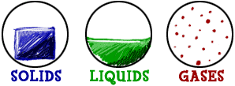
Ch 16 Solids, Liquids, and Gases

Slide 2
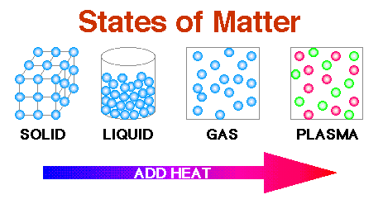

Slide 3
16.1 Kinetic Theory
WYNTK:
What is the KMTM?
Can you describe how particles move

Slide 4
A. Kinetic Molecular Theory of Matter
KMTM
All matter is composed of small particles (atoms, molecules, and ions.)
These particles are in constant and random motion
These particles are colliding w each other and the walls of their container.

Slide 5
B. Thermal Energy
Total energy of a material particles (vibrations)
Warmer – more movement
Cooler – less movement
What is Kinetic Energy???

Slide 6
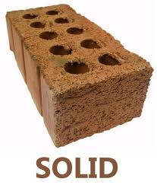
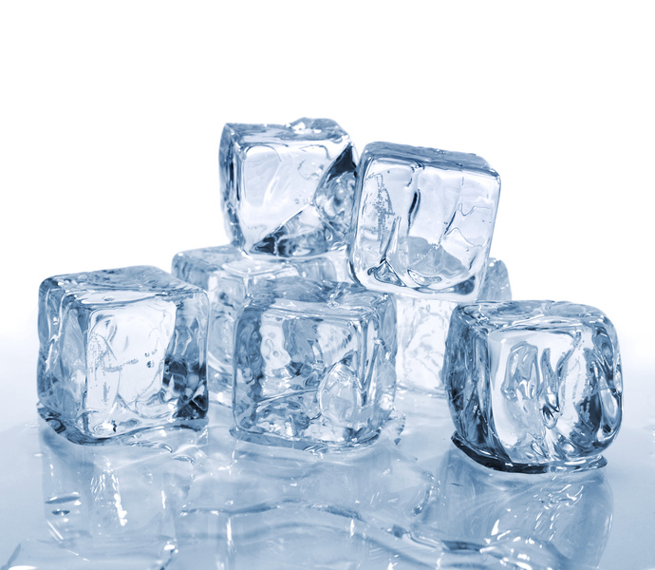
C. Solid State
Most have specific geometric shape
Most dense (except water)
Specific shape, volume
Crystaline vs. amorphous

Slide 7
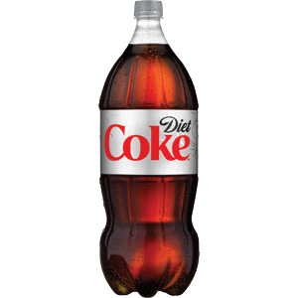
D. Liquid State
Specific volume, no specific shape, ability to flow.
Higher thermal energy
Melting point – slips from solid to liquid
Heat of fusion – amt of energy take to change 1 degree C.

Slide 8
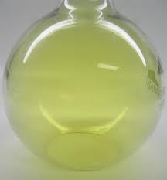
E. Gas State
No fixed shape or volume. Con be compressed
Have the ability to flow
Vaporization (bottom)/Evaporation (top) – going from liquid to gas
Higher thermal/ kinetic energy
Heat of vaporization – amt of energy needed to boil

Slide 9
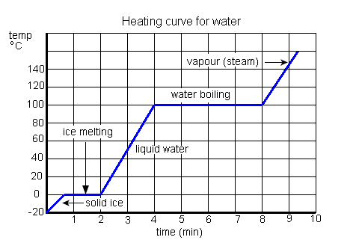

Slide 10
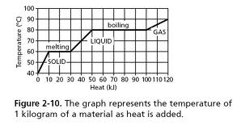

Slide 11
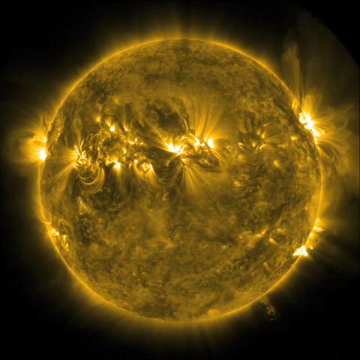
F. Plasma State
Particles hit so hard, electrons fly off.
Sun, stars, lightning bolts neon lights.
Most common in universe

Slide 12
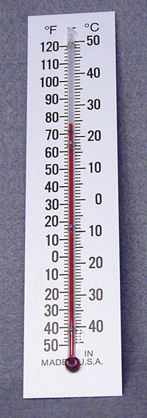
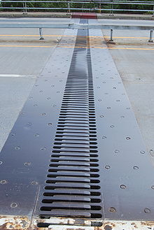
F. Thermal Expansion
More kinetic energy, more expansion

Slide 13
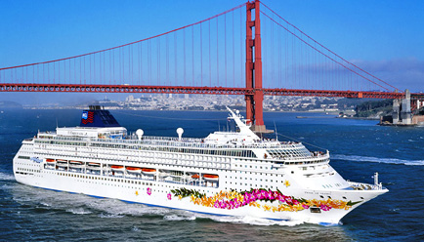
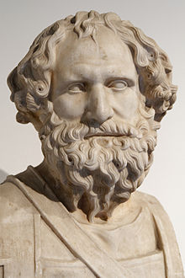
16.2 Properties of Fluids Liquid or gas
A. Archimedes’ Principle – buoyant force is equal to the weight of the fluid displaced by the object.

Slide 15
B. Pascal’s Principle
Pressure is force exerted per unit area
P = F/A
When you squeeze one end of something, the pressure is transmitted unchanged
-applies to hydraulic pumps.

Slide 16
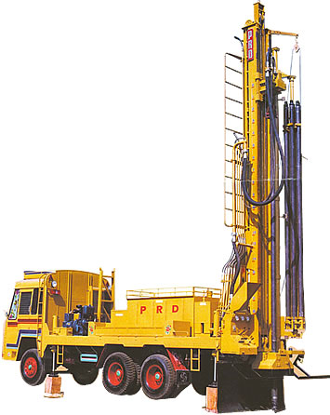

Slide 17
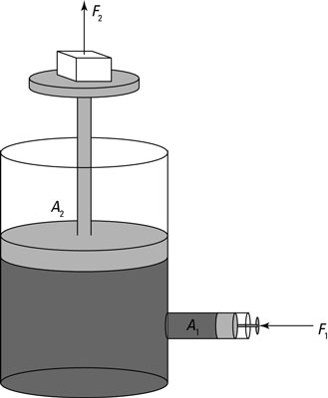

Slide 18
C. Bernoulli’s Principle
Faster the air moves, the lower the pressure

Slide 19
