Slide 1
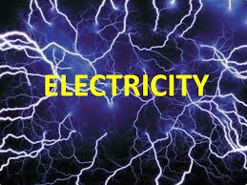

Slide 2
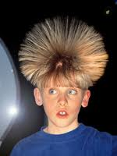
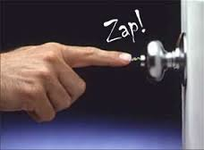

Slide 4
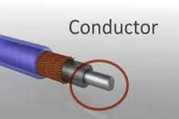
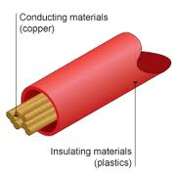
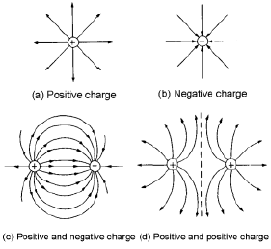
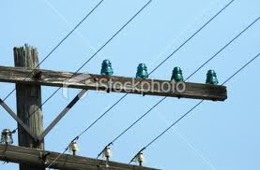
B. Rules of e-charged objects….
1. Law of conservation of charge
2. Opposite attract, same repel
3. e- move easily through conductors, and do not move easily through insulators.

Slide 5
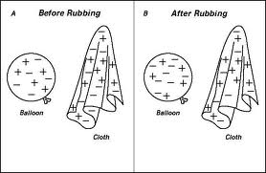
Don’t have to write!

Slide 6
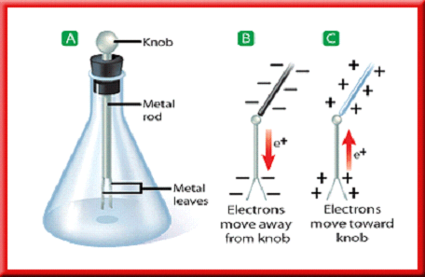
3. Static discharge
Transfer of charge through eh air b/w 2 objects
Lightning
Electric charge can be detected through electroscope.

Slide 7
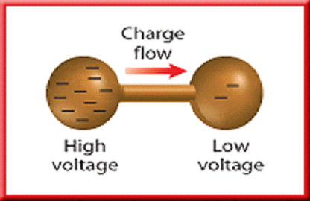
Section 2. Electric Current
The flow of charges through a wire or conductor
Current – flow of e- (Amperes) (A)
Flow from high to low
Voltage difference is the push that causes charges to move (volts (V))
For charges to flow, the wire must always be connected in a closed path, or circuit.

Slide 8
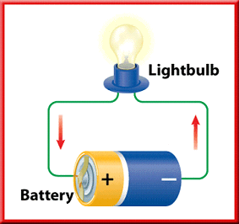

Slide 9
5. Direct – DC – Does not change direction
Alternating – AC – can change direction
A switch that regularly reverses the direction of the current in a motor is a(n) commutator.

Slide 10
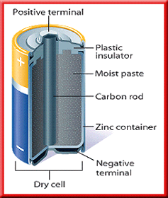
Constant Current!!!!
The cell is called a dry cell because the electrolyte is a moist paste, and not a liquid solution.

Slide 11
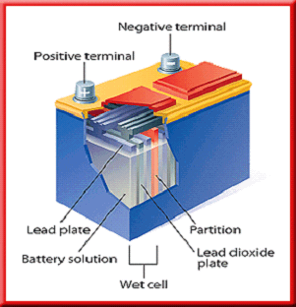
Don’t have to write!!!
A wet-cell battery contains several wet cells connected together.

Slide 12
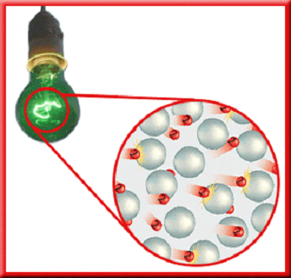

Slide 13
Ohm’s Law
V=IR
V - voltage difference (volts, v)
I - current (ampere, A)
R - resistance (ohm, W)

Slide 14
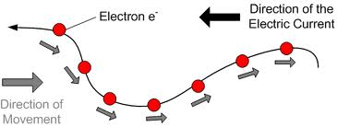
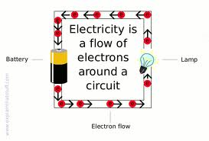

Slide 16
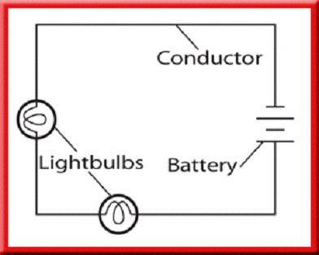

Slide 17
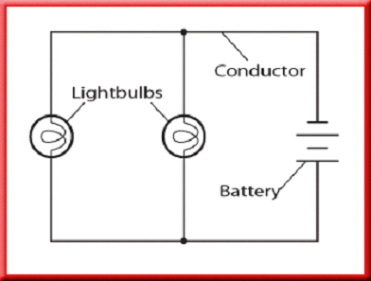

Slide 18
Brain Pop
Electric Circuits

Slide 19
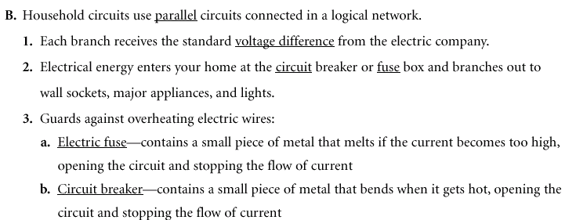

Slide 20
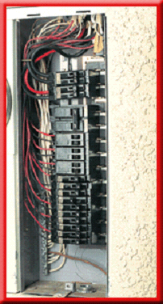
The bending causes a switch to flip and open the circuit, stopping the flow of current.
Circuit breakers usually can be reset by pushing the switch to its "on" position.

Slide 21
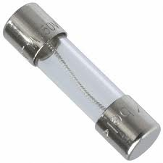
A fuse has a piece of metal that melts if the current becomes too high, opening the circuit and stopping the flow of current.

Slide 22
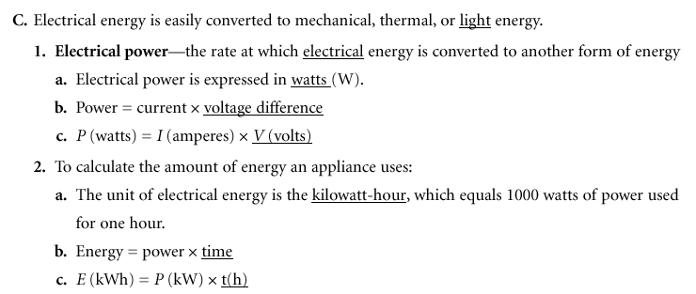

Slide 23
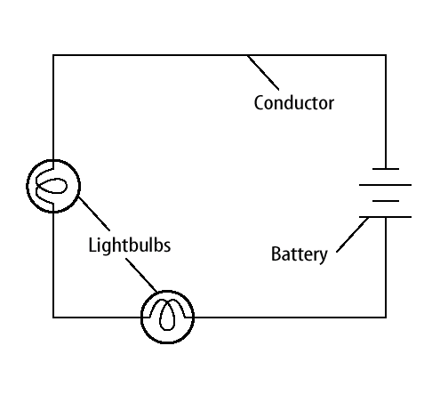
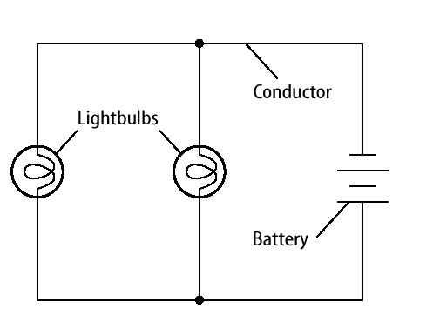
Which is a series and which is parallel?

Slide 24
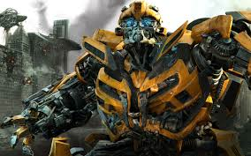

Slide 25
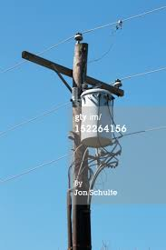
D. Transformers
A device that increases or decreases voltage in a power line
Has primary and secondary wire coils
Increases voltage called step up, decreases voltage called step down
In the US, power lines can carry power voltages as high as 750,000V, a step down transformer reduced the voltage to 120 V for home use.

Slide 29
In a step up transformer, the number of turns of wire is greater in the secondary coil than in the primary coil, and the output voltage exceeds the input voltage.
Vice Versa

Slide 30
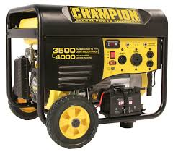
Generator
Turns mechanical energy into electrical energy!!

