Slide 1
Physical Science Chapter 1
The Nature of Science

Slide 2
I. The Methods of Science
Terms –
Scientific Method, hypothesis, experiment, variable, dependent variable, independent variable, constant, control, bias, model, theory, scientific law, technology

Slide 3
WYNTK: (What you need to know)
1. Steps Scientists use to solve problems
2. Why use variables?
3. Science vs. technology

Slide 4
A. 7 Steps to experimenting:
1. State the problem
2. Gather Information
3. Hypothesis - educated guess based on knowledge and observations
If /then has to be able to be tested
Can be supported or not supported
4. List Materials
5. Procedure - the actual steps
6. Results - data (graphs, charts, tables)
7. Conclusion - interpret results

Slide 5
B. Variables
Only one can change for valid experiment
DRY MIX
Dependent - (Responding) - Y Axis - The results
Independent - (Manipulated) - X axis - What you choose to change
Constant - Stays the same
Control - Standard for comparison

Slide 6
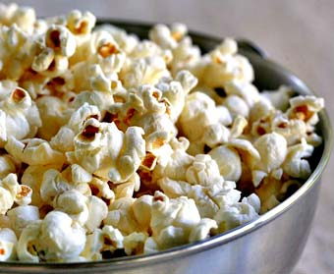
Ex:
Pop Corn in Freezer

Slide 7
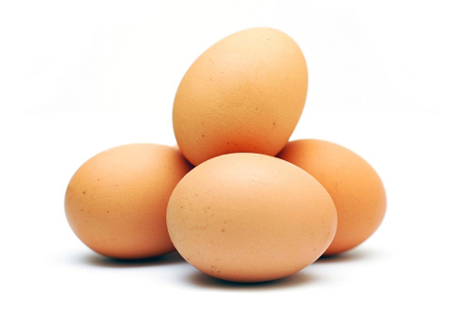
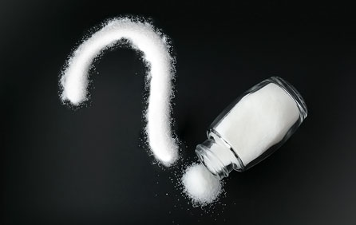
Experiment
The Salty Egg

Slide 8
C.
Bias - expecting an outcome
Theory - possible explanation of why something happens
Law - seems to happen ALL the time, but required no explanation

Slide 9
D.
Technology is the use of science into our every day lives

Slide 10
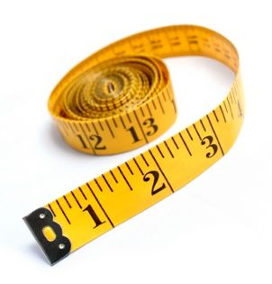
II. Standards of Measurement
Terms - Standard, SI, volume, mass, density

Slide 11
WYNTK :
1. Name prefixes
2. Identify SI units
3. Convert

Slide 12
A. SI Units
- used worldwide
- by tens
- prefixes
- derived units - combining 2 units
Cm3, g/mL

Slide 13
B. Types
Length - Meters
Volume - Liters
1 mL = 1 cm3
Mass - Grams
Density - mass per unit volume
D = M/V
Time - Seconds
Temp- Kelvin
0 K - absolute 0
C + 273 = K
0 C = 273 K
273 k water freezes
373 K water boils

Slide 14
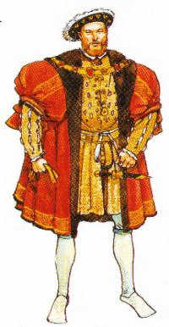
King Henry’s Daughter Usually Drinks Chocolate Milk

Slide 15
Measurement Lab (Just Objects)
Measurement Lab Stations

Slide 16
III. Communicating with Graphs
Terms - graph

Slide 17
WYNTK:
1. List 3 types of graphs
2. Identify the dependent and independent variables
3. Analyze data in graphs

Slide 18
Line (DRY MIX) - trend over time
Bar - Survey, general information
Pie - How a whole is divided up

