Slide 1
Endocrine System

Slide 2
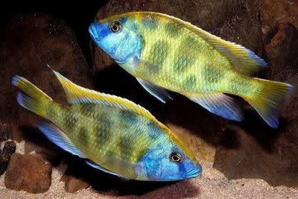
Testosterone and Male Aggression: Is there a link?
What do male hormones control?
What is another name for adrenaline?
Do you think testosterone
makes people more
aggressive?
Rugby video

Slide 3
Chemical Regulation
A. Hormones – secreted into BODY FLUIDS
  Regulate body function
  Produced by endocrine glands
  They Control
    Metabolic rate, growth, maturation, reproduction, stress, dehydrations, low glucose
  Target Cells Respond
  They TRIVE on NEGATIVE FEEDBACK

Slide 4
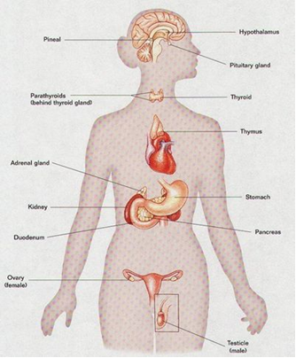

Slide 5
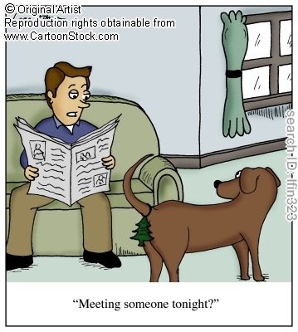
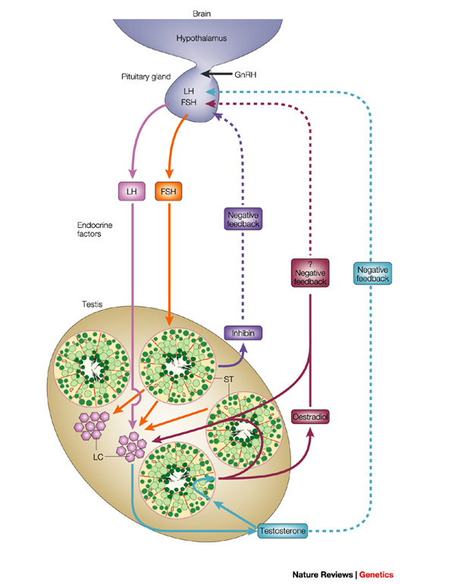
B.
Local regulators – direct secreted into interstitial fluid and affect only nearby target cells.
Pheromones – between other individuals

Slide 6
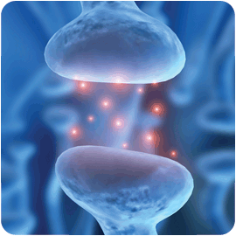
C. The endocrine and nervous system work together.
  Nervous works in split second
  Endocrine works in minutes / days.
  Neurotransmitter – chemical that carries info to other nerve, endocrine cell, or a
  cell that can react (muscle)

Slide 7
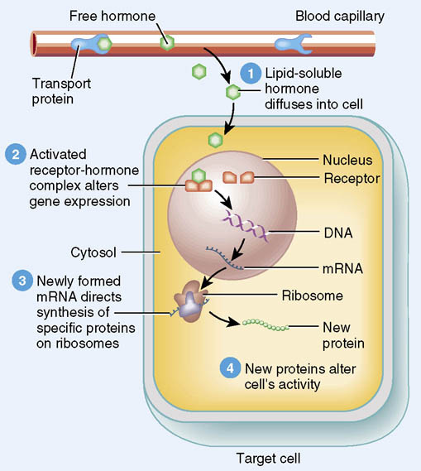
Target Cells – cells in organs that respond to specific hormones
Types of hormones
Steroid – made of
cholesterol, enter cell
membrane bonding with
DNA and causing
the production of more
protein

Slide 8
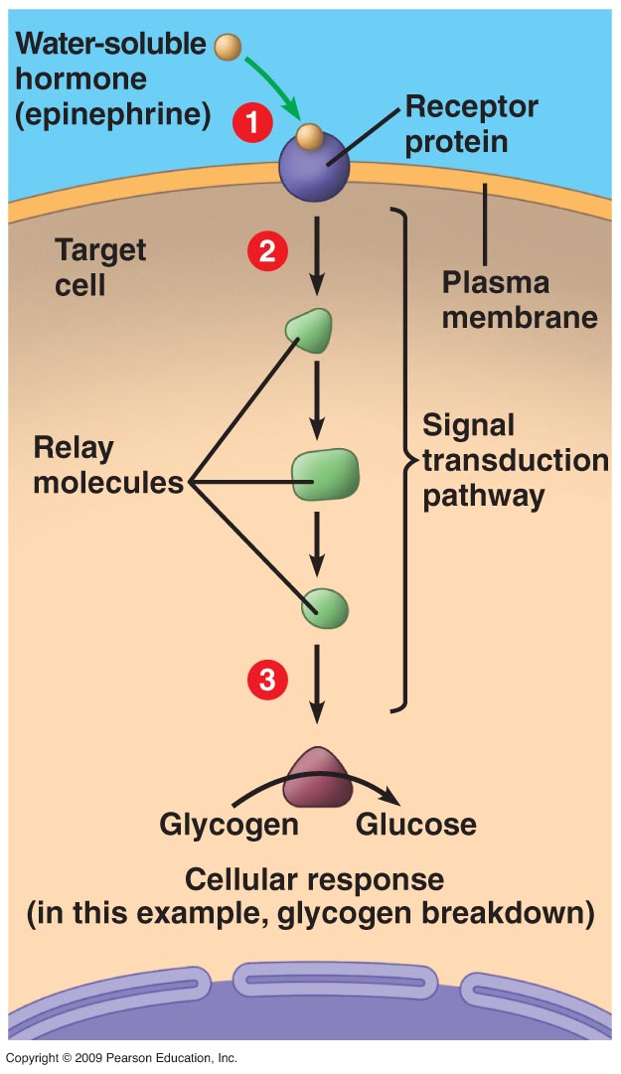
2. Non-Steroid – made of amino acids, bind to cell mem of target cells and cause certain chemical rxn to take place inside the cell.

Slide 9
– The vertebrate endocrine system
- Goes into blood

Slide 10
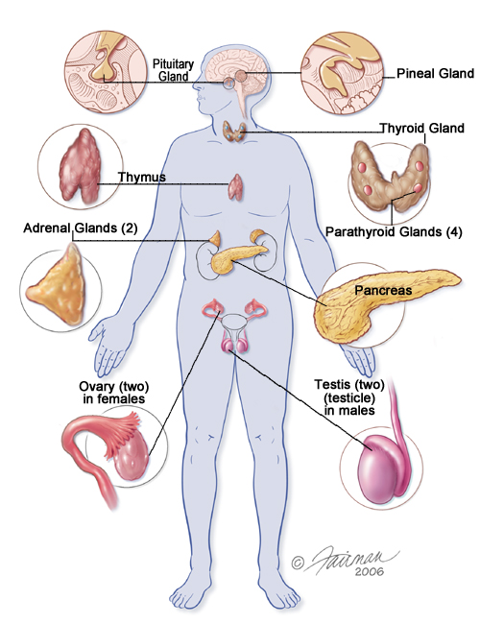

Slide 11
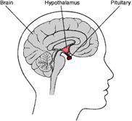
Main hormone secreting glands:
Hypothalamus controls pituitary gland –
The PITUITARY GLAND is called the master gland. It regulates all other glands and secretes growth hormone.
Growth Hormone (GH) – stimulates growth
too much – gigantism
too little - dwarfism

Slide 12
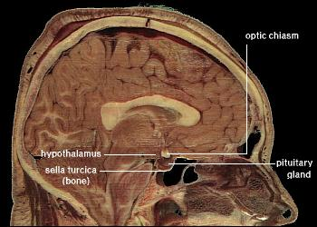
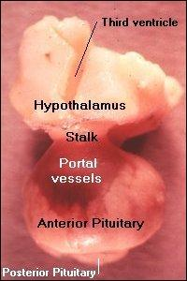

Slide 13
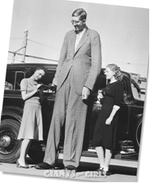

World’s Largest Humans

Slide 14


Slide 15
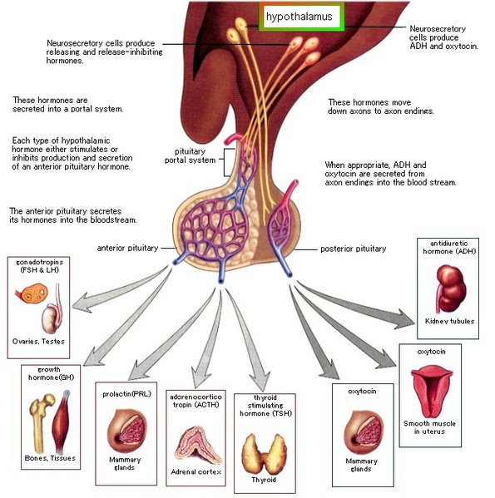

Slide 16
LH (Lutenizing Hormone) – stimulates ovaries and testes
FSH (Follicle Stimulating Hormone) – Stimulates egg and sperm production
TSH (Thyroid Stimulation Hormone) – Stimulate thyroid gland for metabolism

Slide 17
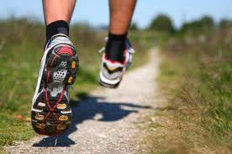
Endorphins – natural pain killers
  Made by pituitary

Slide 18
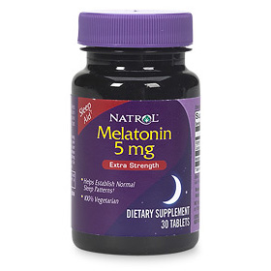
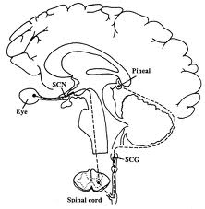
Pineal Gland – Melatonin
  Days and nights

Slide 19
Calcitonin – lowers blood Ca

Slide 20
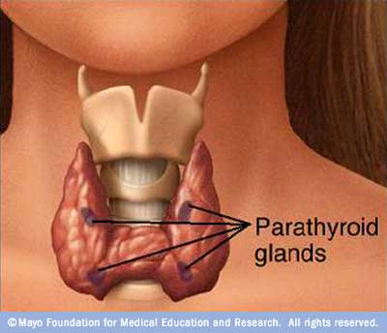
Parathyroid Glands – Parathyroid hormone (PTH)
Raises blood Ca Level.

Slide 21


Slide 23
…..Read about diabetes
Why can high levels of glucose build up in the blood if you are diabetic?
Which type of diabetes can form due to being overweight or underactive?
Which type is considered to be an autoimmune disease?
Where does the insulin come from that people inject?
What are some symptoms of diabetes?
How is hypoglycemia and occasional low blood sugar different?

Slide 24
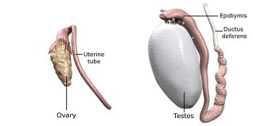
Gonads – sex organs
  Estrogens, progestins, and androgens

Slide 25
Follicle-stimulating Hormone (FSH) – Stimulates production of ova and sperm
Luteinizing Hormone (LH) – Stimulates ovaries and testes

Slide 26
Testosterone wins games

