Slide 1
Evolution: Unit 5
Review for test!

Slide 2
Darwin drew ideas for his theory from observations of organisms on ____________.

Slide 3
List one of the four principles of natural selection.

Slide 4
The species of finches that Darwin observed differed in the shape of their beaks. According to Darwin, all of these species probably _____________.

Slide 5
List one of the four principles of natural selection.

Slide 6
List one of the four principles of natural selection.

Slide 7
The process by which a population become better suited to its environment is called ___________.

Slide 8
List one of the four principles of natural selection.

Slide 9
_________________ is the process by which organisms with traits well suited to their environment survive and reproduce more successfully than organisms less suited to the same environment.

Slide 10
Population of the same species living in different places become increasingly different as each population becomes adapted to its own ______________.

Slide 11
A scientist is curious only about the change of tigers over time. Would this be macro or micro evolution?

Slide 12
Natural selection could not occur without ___________ variation.

Slide 13
_________ is the term used to describe evolution occurring at a slow, constant rate.

Slide 14
____________ shape in finches is affected by the availably of food.

Slide 15
In natural selection, the selective agent is the _______________.

Slide 16
______________ is the observable change in the allele frequencies of a poulation over time.

Slide 17
A frog that can easily out-compete other frogs for food and can produce many eggs has a high ________________.

Slide 18
Before the industrial revolution, what color of peppered moth was more common?

Slide 19
After the industrial revolution, what color of peppered moth was more common?

Slide 20
When individuals from two populations of lizards can not longer successfully mate with each other, the change that ______________ will occur increases.

Slide 21
List one way that variation in a genotype can occur.

Slide 22
Individuals from a wasp population on a continent were carried to an island with another population of the same species of wasp by a hurricane. What is this an example of?

Slide 23
Scarcity of resources and a growing population are most likely to result in ____________.

Slide 24
If a population is not evolving, it is said to be in ________________.

Slide 25
__________ ______________ describes the movement of genes from one population to another.

Slide 26
The combined alleles of all the individuals in a population is called the ____________.

Slide 27
Is genetic variation random?

Slide 28
Is natural selection random?

Slide 29
List 1 of the 5 conditions that has to occur for NO EVOLUTION to occur? HWE

Slide 30
List 1 of the 5 conditions that has to occur for NO EVOLUTION to occur? HWE

Slide 31
List 1 of the 5 conditions that has to occur for NO EVOLUTION to occur? HWE

Slide 32
_________________ is when 2 or more species become more adapted over time to each others presence.

Slide 33
List one of the 4 types of Isolation that can cause speciation.

Slide 34
List one of the 4 types of Isolation that can cause speciation.

Slide 35
Is this evidence of a common ancestor?

Slide 36
Anatomical structures that appear to have derived from a functional structure in an ancestor, but that currently do not serve an important function (like wisdom teeth) are called _______________.

Slide 37
The wings of a bird and a moth evolved independently yet both serve the same function for the organisms. The wings are ______________.

Slide 38
The modern synthesis of evolutionary theory predicts that closely related species will show _______________ in DNA sequences.

Slide 40
If 2 organisms share the same environment, so the have analogous structures like a shark and a dolphin, they are said to be an example of __________________.

Slide 41
What can this show us?

Slide 42
According to this diagram, Were ferns present on earth before or after fish?

Slide 43
This is a picture
of a ______________.

Slide 44
If an alligator and a lizard share 99% of the same amino acids to make catalase, and an alligator and a snake share 73% of the same amino acids to make catalase, which one would you say is a more recent common ancestor?

Slide 45
List one way that variation in a genotype can occur.

Slide 46
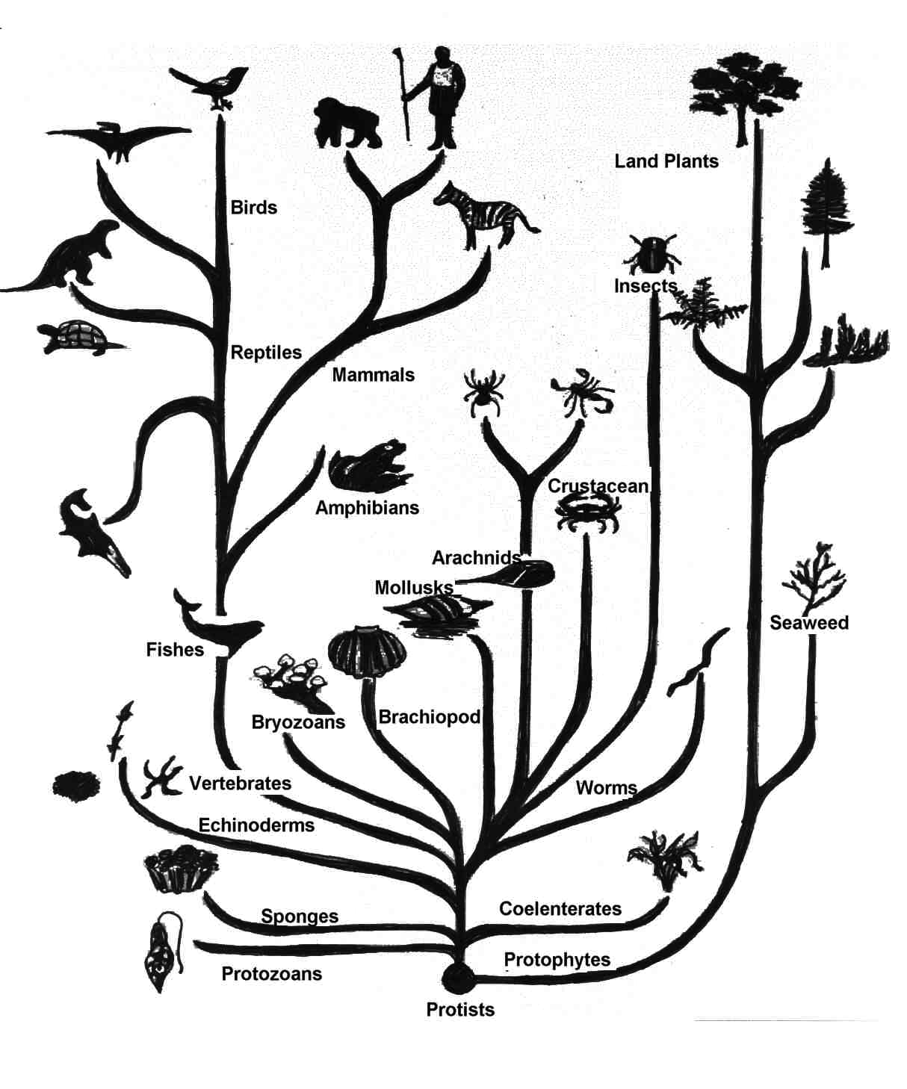
According to the diagram,
which 2 organism are most closely related?
Turtle and zebra
Turtle and T rex
Turtle and amphibians

