Slide 1
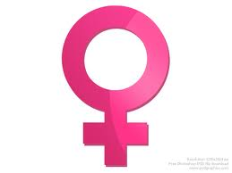
The Female Reproductive System

Slide 2
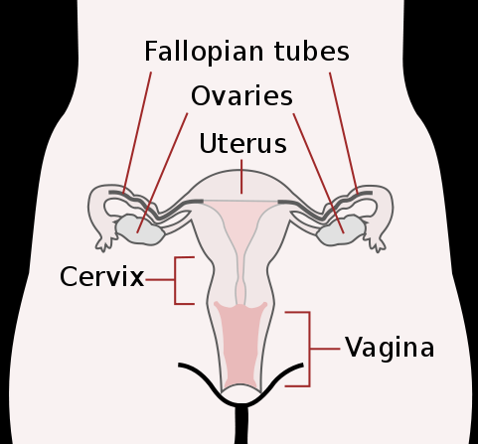
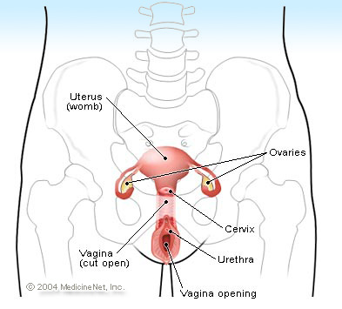
Female Reproductive Organs

Slide 3
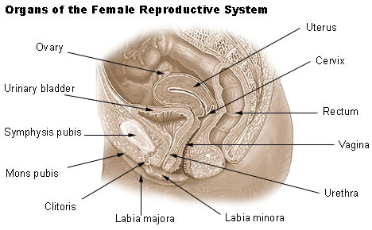

Slide 4
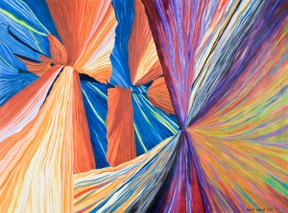
Purposes of the Female Reproductive System
To produce egg cells (ova)
To support a developing embryo (baby) during pregnancy (gestation)
Primary Hormone: Estrogen
Causes femininity: wider hips, fat deposits, enlarged breasts
2. Promotes egg maturity.
3. Prepares the uterus for pregnancy each month, maintains the uterus during pregnancy

Slide 5
Oogenesis Begins Before Birth
a. While in the womb, oogenesis begin rapidly producing primary oocytes each with 46 chromosomes until about 2,000,000 have been made and stored in the ovaries.
b. Once a little girl is born many of these cells die throughout her life as she approaches puberty. Halt at Prophase I.
c. At puberty, a 28-day cycle begins when FSH stimulates an egg to complete its first division of meiosis producing one large cell and 1 tiny polar body. Halt at metaphase II.(The polar body has DNA, but little or no cytoplasm, it will die.) In some species this polar body may divide again, but in humans it does not.
d. The larger cell receives all of the cytoplasm, organelles, and nutrients. If it is fertilized by a sperm cell it will divide once again producing the egg (23 chromosomes) and 1 polar body which will eventually die.

Slide 6
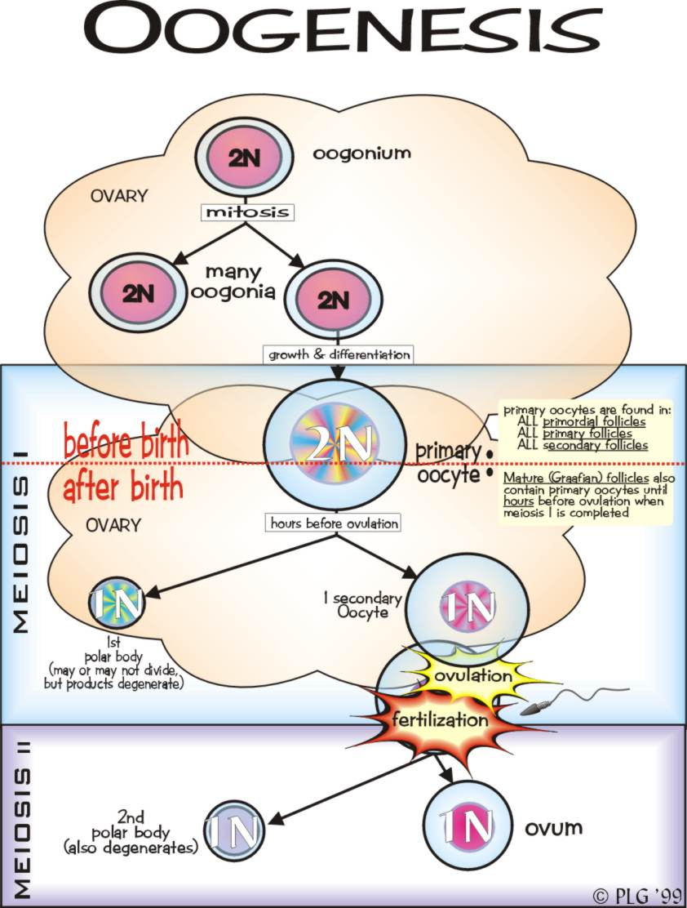

Slide 7
The Menstrual (28-day) Cycle
Days 1-5: FLOW PHASE: The uterine lining is shed. FSH and LH stimulate another egg to mature (complete meiosis)
Days 6-14: FOLLICULAR PHASE: The endometrial lining thickens. Ovulation (the release of the new egg) occurs.
Days 14-28: LUTEAL PHASE: Egg production stops and the endometrium is prepared for pregnancy.
If the egg is not fertilized, the uterine lining is shed…Day 1 (Flow Phase)

Slide 8
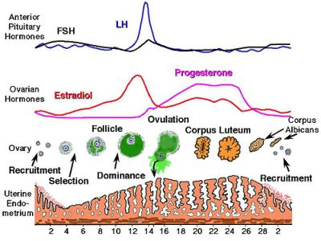
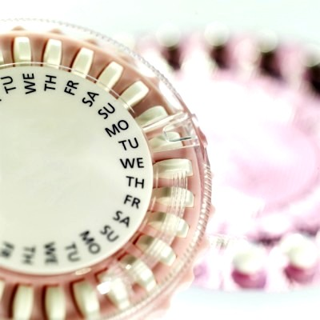
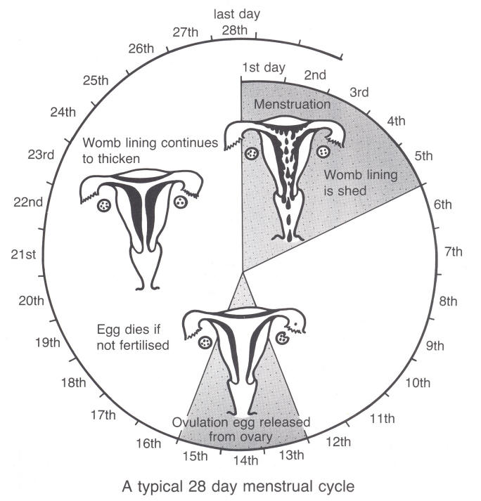

Slide 9
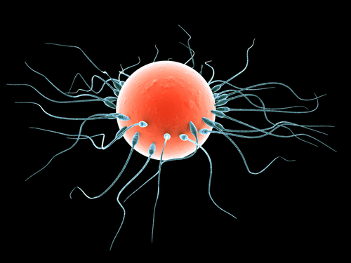
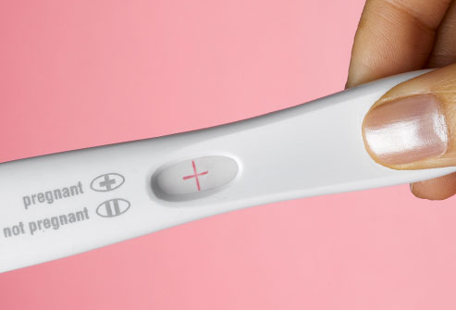
Pregnancy / Gestation
If the egg is fertilized by a sperm cell, a zygote forms.
The zygote divides rapidly as it travels into the uterus that has prepared for its arrival by building up a fresh blood supply and growing new blood vessels.
A hollow ball of cells forms and implants in the lining of the uterus. Its 3 layers are the endoderm (digestive system), mesoderm (muscles), and ectoderm (skin & nerves).

Slide 10
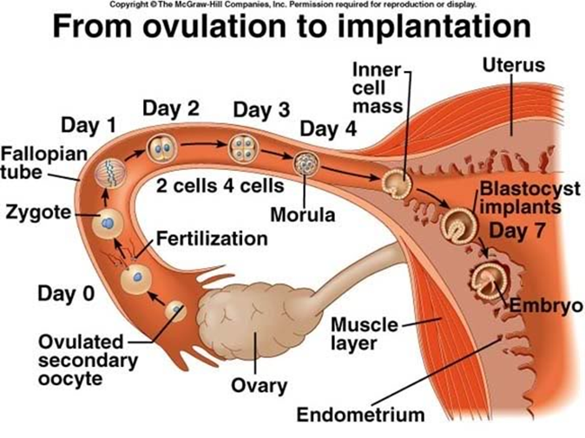

Slide 11
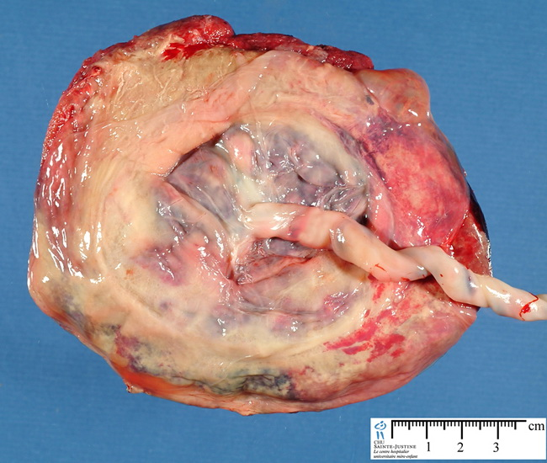
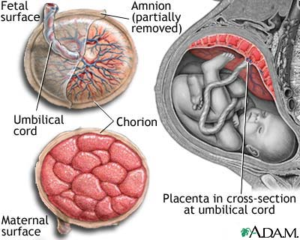

Slide 12
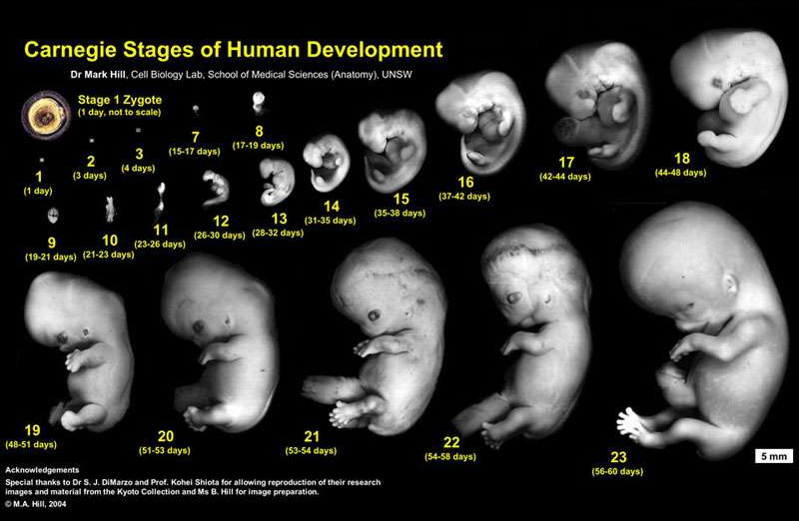
24 Random Facts about Pregnancy

