Slide 1
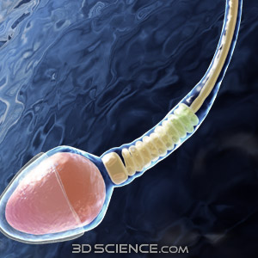
The Male Reproductive System

Slide 2
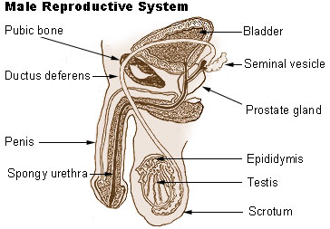
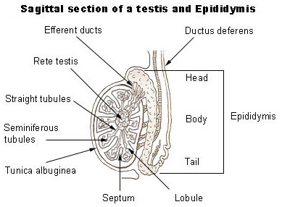

Slide 3
Function of the Male Reproductive System
To produce sperm
To deliver sperm to the female reproductive system
The primary hormone is testosterone.
Stimulate the production of sperm cells.
Causes masculinity—muscle mass, body hair, aggression, deeper voice
Miracle of Life

Slide 4
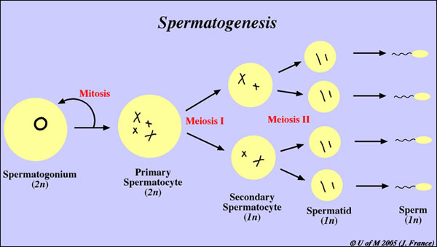
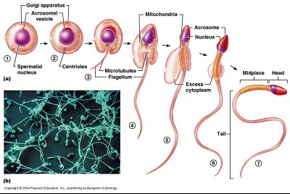
Spermatogenesis
Occurs in the testes, beginning at puberty.
Sperm mature as they travel through the epididymis.

Slide 5
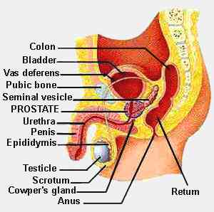
What is Semen?
During sexual stimulation, sperm cells travel through a tube called the Vas Deferens where it mixes with other fluids to become semen.
The prostate gland (around the urethra) adds a fluid that helps sperm to swim more easily.
The bulbourethral gland and the seminal vesicle secrete alkaline (basic) fluids to help neutralize the acidity of the female’s vagina and prolong the life of the sperm.

