Slide 1
Chapter 4
ENERGY

Slide 2
Section 1 : The Nature of Energy
Energy is the ability to cause change
Types of energy
1. Kinetic
2. Potential
Elastic Potential
Chemical Potential
Gravitational Potential
Energy Measured in Joules (J)

Slide 3
1. Kinetic Energy
Energy in the form of motion
Amount of KE depends on mass and velocity
KE = ½ m x v²

Slide 4
2. Potential energy
Energy stored in motionless object
Elastic PE– stored in the things that stretch or compress (rubber band, spring)
Chemical PE – energy stored in chemical bonds (food, fuel)
Gravitational PE – energy store by things above Earth

Slide 5
More on GPE………
Gravitational PE – depends on it mass, the acceleration due to gravity, and its height above ground
GPE = m x 9.8m/s² x h
Any thing that can fall has GPE
(a pen sitting on the desk)

Slide 6
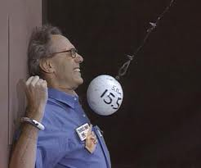
Section 2: Conservation of Energy
Energy can change from one form to another
Law of Conservation of Energy – energy may change from one form to another, but the total amount of energy never changes.
As a swing moves back and forth, its energy continually converts from kinetic to potential and back.
If the energy of the swing decreases, then has to be given to some other form
FRICTION converts some of the
mechanical energy into thermal
energy (rub hands together, race car tires)

Slide 7
Mechanical Energy –
ME = PE + KE

Slide 8
So as KE increases – PE decreases! They just switch back and forth!!
Both together or ME

Slide 9
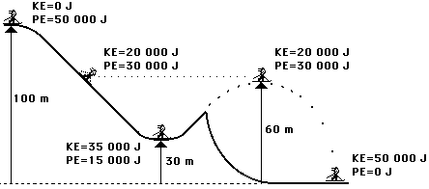

Slide 10
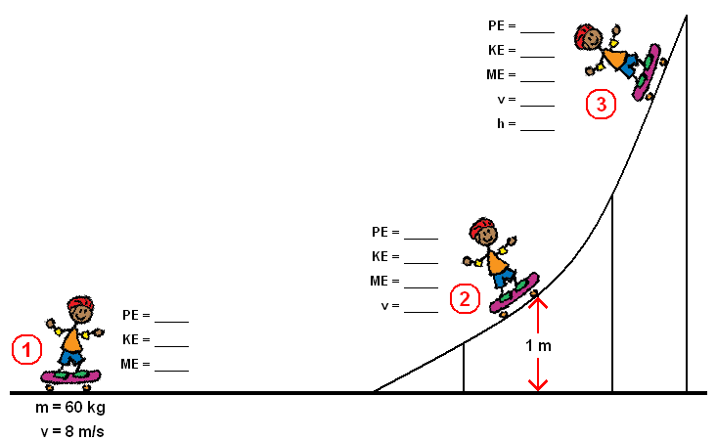

Slide 11
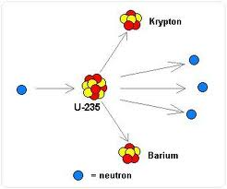
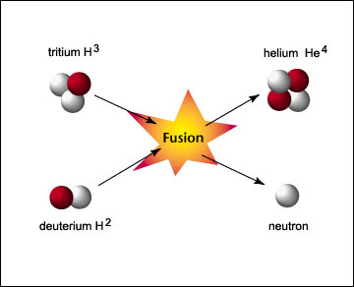
Converting Mass into Energy
Nuclear fusion – 2 nuclei are fused together – takes place in the sun
Nuclear fission – 2 nuclei are broken apart
Fusion
Fission

Slide 12
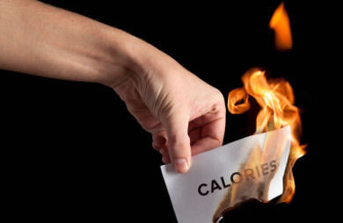
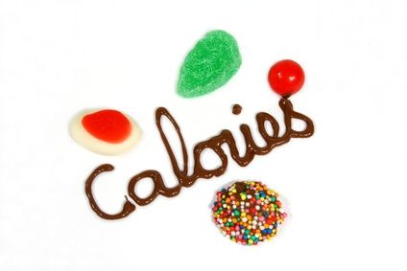
Conservation of energy in your body
Chemical potential energy from food that is stored in your body is used to fuel the processes that keep you alive.
Calorie – measurement of energy from food.
1 calorie is = to 4,180J

Slide 13
