Slide 2
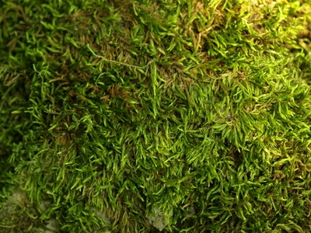
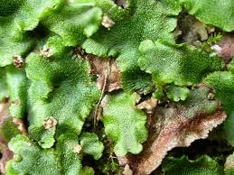
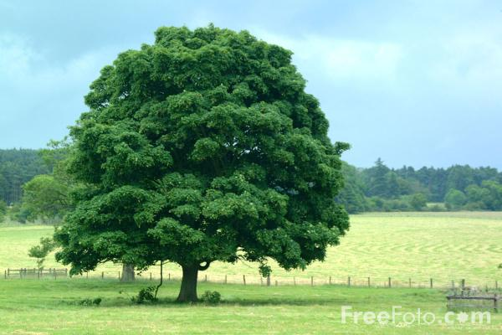
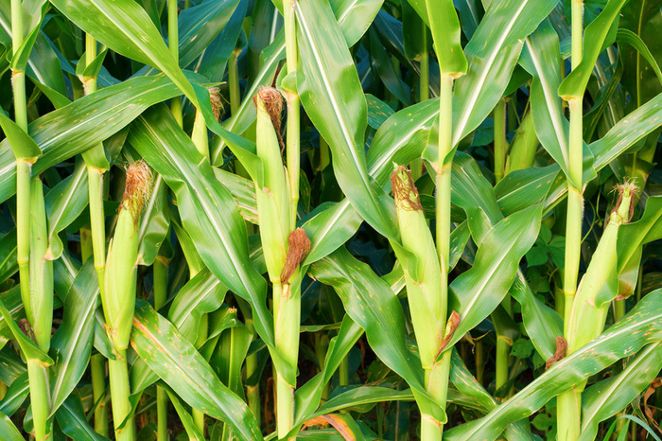
Plants
Classification
1. Nonvascular: have no vessels, no roots, no stems or leaves.
Ex: Mosses & Liverworts
2. Vascular: have vessels to transport food and water. They have roots, stems and leaves.
Ex: Grass, corn, trees, flowers, bushes

Slide 3
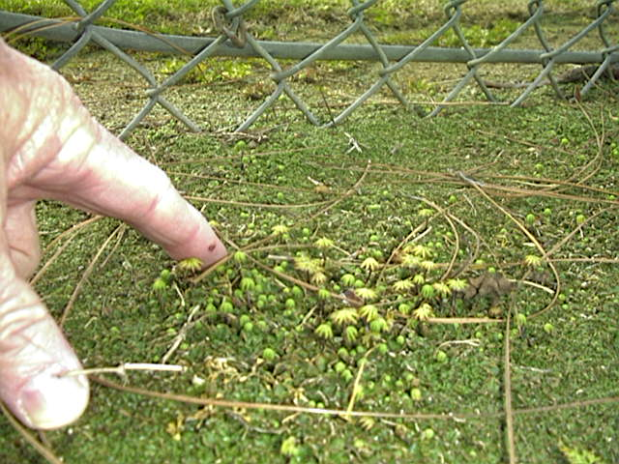

Slide 4
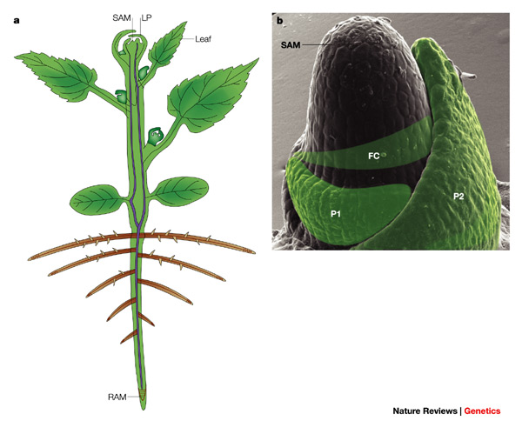
Getting resources
Apical meristem – growth producing regions
Vascular tissue – veins
Xylem – water, mineral from roots
Layers of dead and living cells
Phloem – takes sugars to plant
Layers of living cells

Slide 5
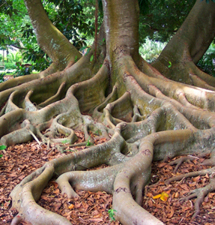
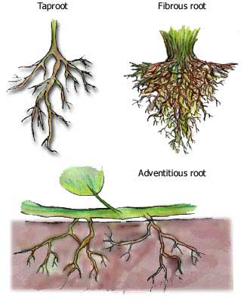
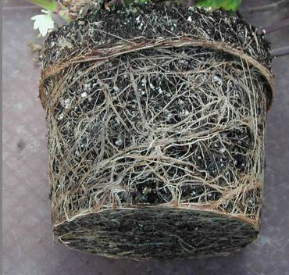

Slide 6
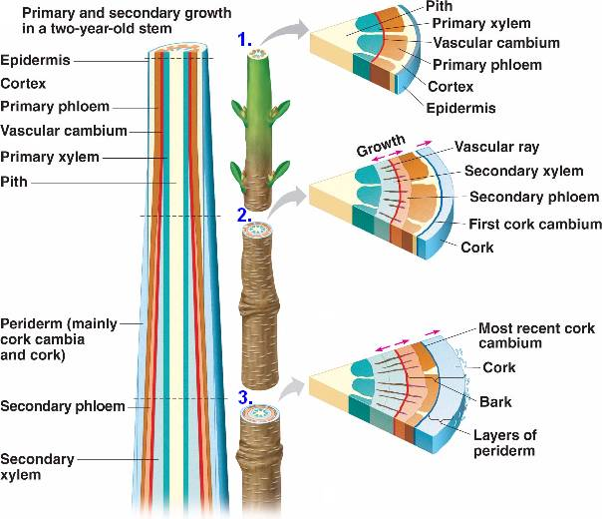

Slide 7
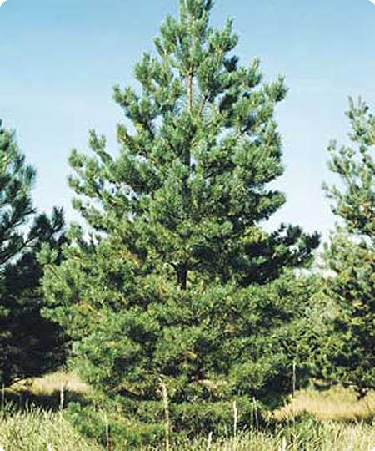
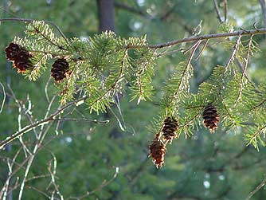
Types of Vascular plants
Gymnosperms
"naked seeds"
cone bearing plants (seeds grow on cones)
needle like leaves
usually stay green year round
wind pollinated
Ex: pine trees & evergreens

Slide 8
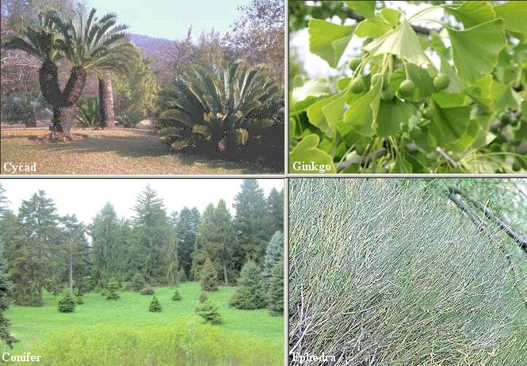

Slide 9
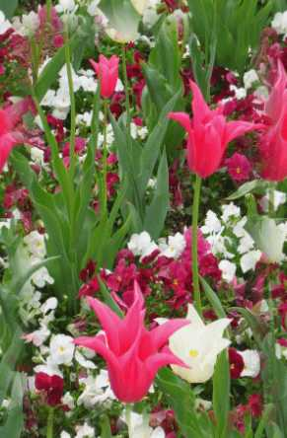
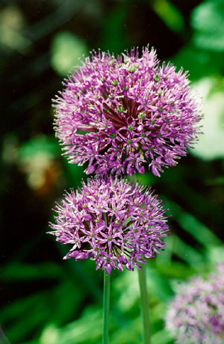
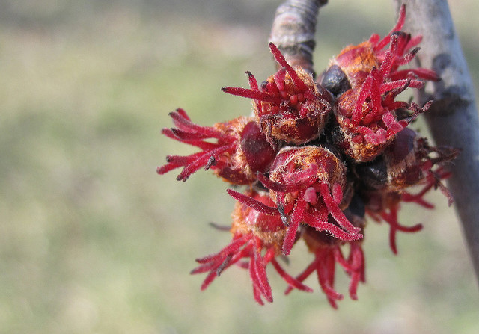
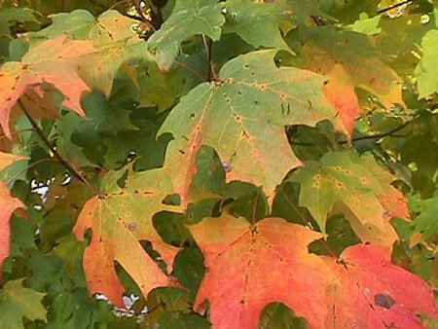
Angiosperms
flowering plants
seeds are enclosed in a fruit
most are pollinated by birds & bees
have finite growing seasons
Examples: grasses, tulips, oaks,
dandelions
Divided into two main groups:
Monocots & Dicots

Slide 10
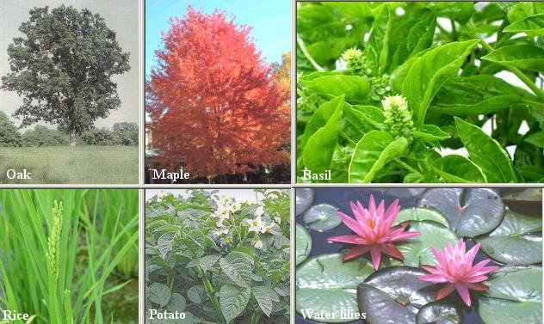

Slide 11
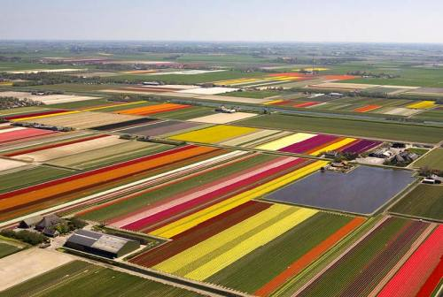

Slide 12
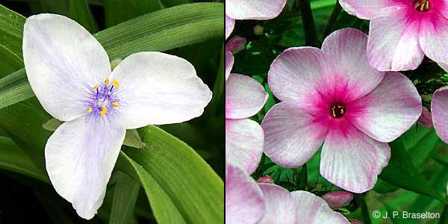
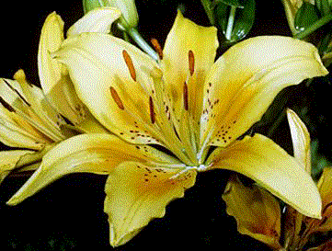
Monocots
Angiosperms have 1 seed leaf (cotyledon)
parallel veins on leaves
3 part symmetry for flowers
fibrous roots
Ex: lilies, onions, corn, grasses, wheat

Slide 13
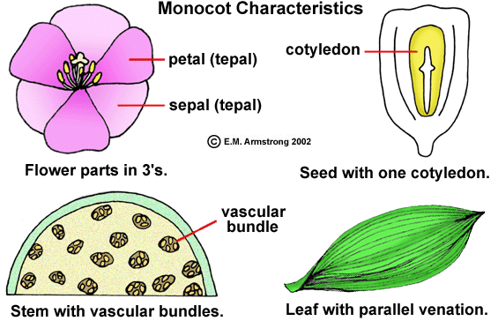

Slide 14
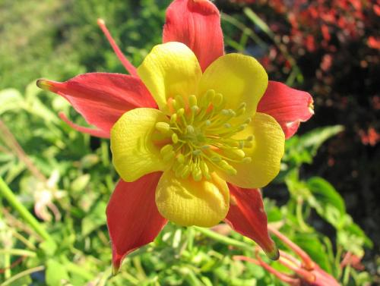
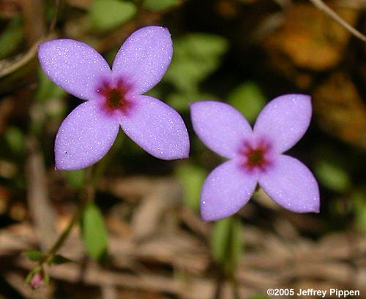
Dicots
Angiosperms that have 2 seed leaves (cotyledons)
net veins on leaves
flowers have 4-5 parts
taproots
Ex: trees and ornamental flowers

Slide 15
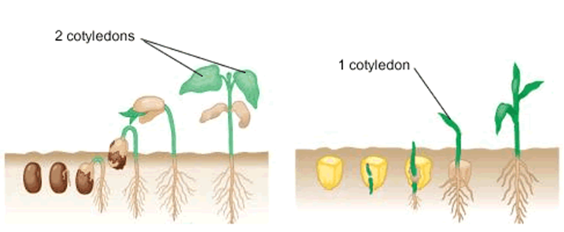
Monocots have 1 seed leaf (cotyledon), Dicots have 2 seed leaves

Slide 16
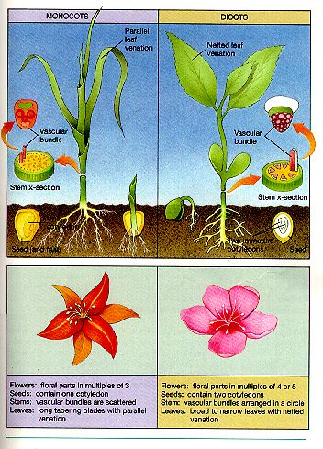

Slide 17
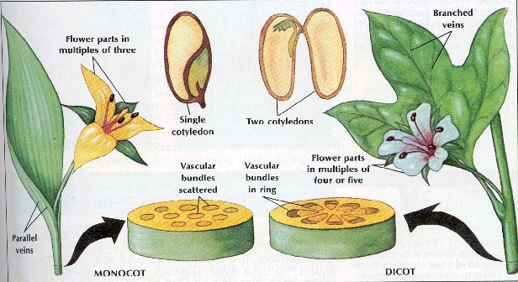

Slide 18
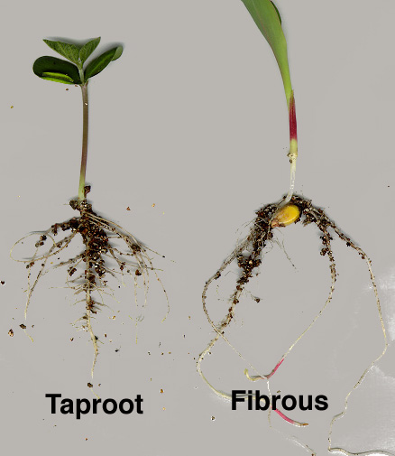
Parts of the Plant
Roots
water and minerals are
absorbed (taproots vs fibrous roots)
also used to anchor
the plant
movement of water up
to leaves is influenced
by TRANSPIRATION

Slide 20
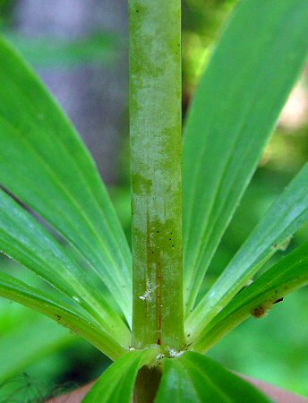
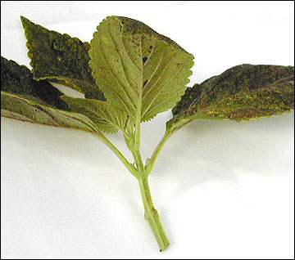
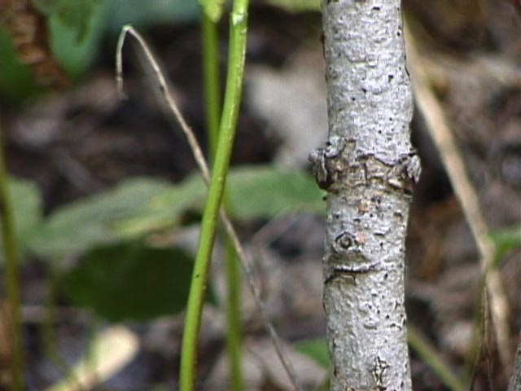
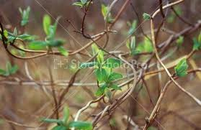
Stems
Support plant
transport water through xylem
transport nutrients through phloem
Two types:
1.herbacious
2. woody

