Slide 1
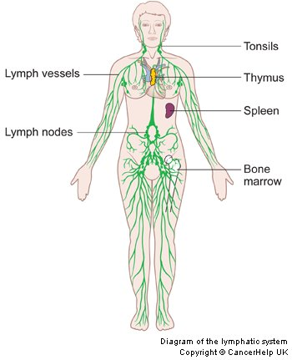
Lymphatic System

Slide 2
Lymphatic system
The primary function is to transport lymph, a clear, colorless fluid containing white blood cells that helps rid the body of toxins, waste and other unwanted materials.
Subset of the circulatory system.
Removal of interstitial fluid
Highway transporting WBC to and from the Lymph nodes into the bones.
Moves antigen-presenting cells to the lymph nodes

Slide 3
Organs
Spleen – Organ that helps remove blood cells
Thymus – Organ in the immune system that makes T cells
Tonsils – masses of lymphoid tissue in the throat.
Lymph Node (650) – filter lymph before going back to the blood.

Slide 5
Lymphocyte is a type of white blood cell
Wanna see more?

