Slide 1
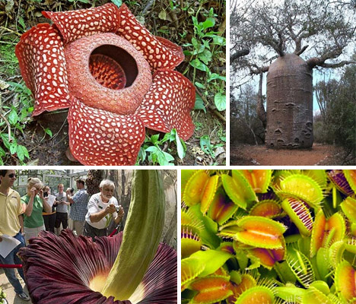
Protists, Fungi, and Plants

Slide 2
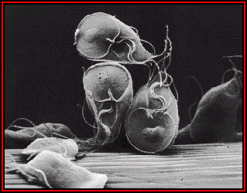
Protists
2 main groups
Algae – can photosynthesize
Protozoan – cannot photosynthesize

Slide 3
16.18 – 16.24

Slide 4
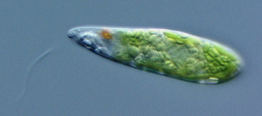
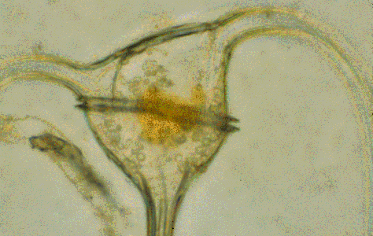
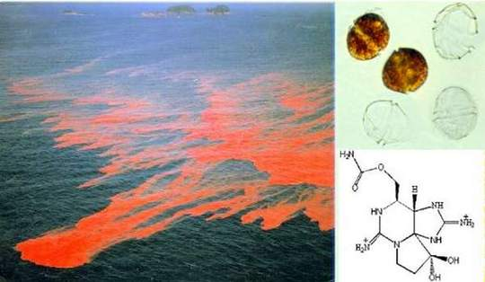
Euglena – with flagella
Common in pond water
Dinoflagellates – 2 flagella
cause red tides

Slide 5
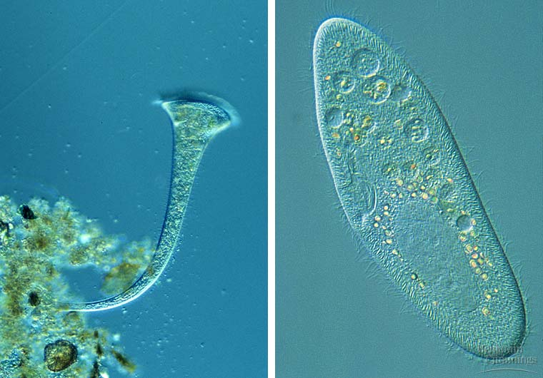
Ciliates – cilia to move and feed
2 types of nuclei (day to day, sexual reproduction)

Slide 6
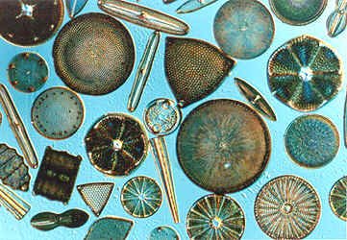
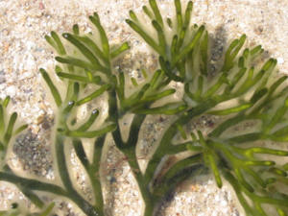
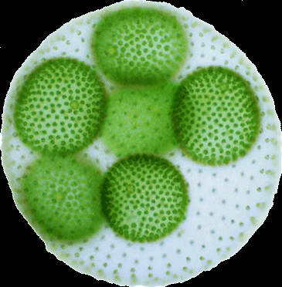
Diatoms – photosynthetic
Glassy cell with silica
Brown / red/ green Algae
Resemble plants but lack true stems
Kelp
Volvox

Slide 7
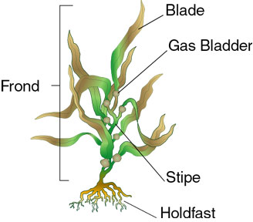
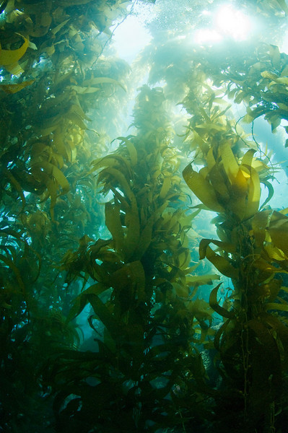
californiakelpforest

Slide 8
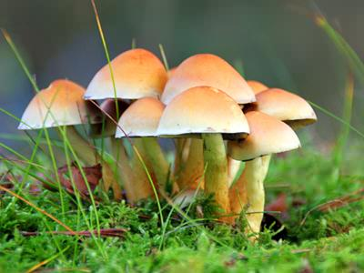
Ch 17 Plants and Fungi

Slide 9
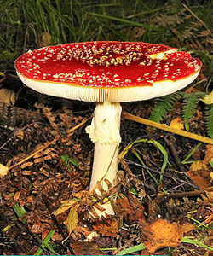
Fungi
digest food outside body, then absorb
The closest ancestor to animals
Hypha – thread like projection (make up all)
Chitin in cell walls
Sexual and asexual
Asexual – produce spores that become air born or picked up on something
Extentions can grow and pinch off
Sexual – emit chemicals that encourage growing towards each other.

Slide 10
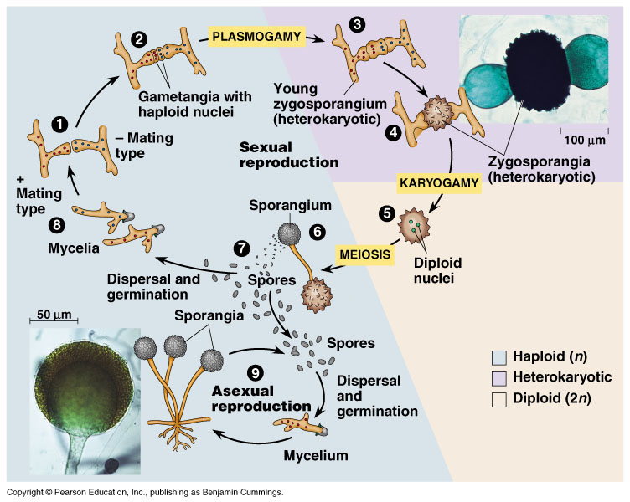

Slide 11
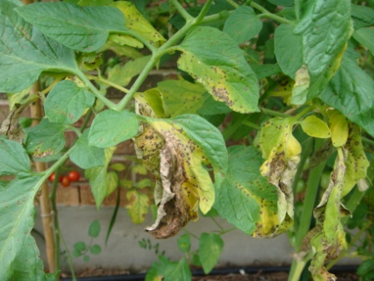
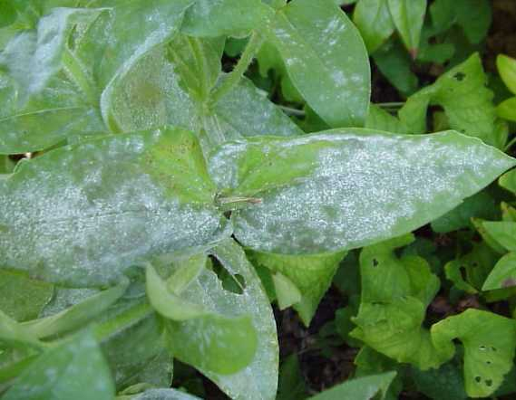
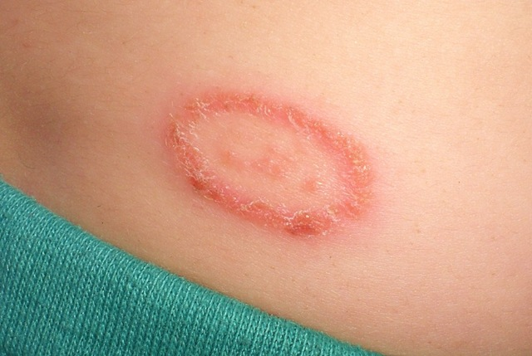
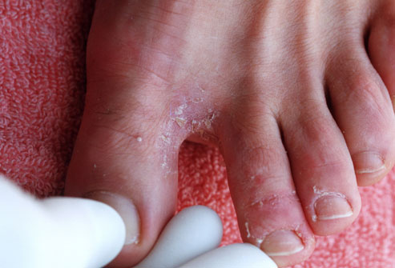
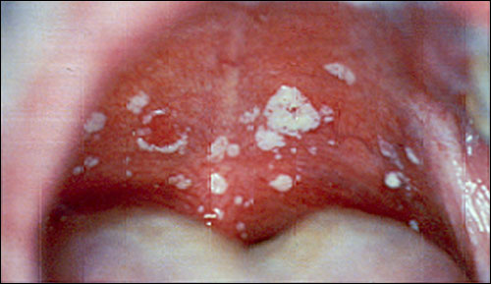
Parasitic fungi
30% of fungi
Elm tree, corn smut,
grain pg 361
Mycosis – skin infection
on animals
Ringworm
Athletes foot
Yeast infections

Slide 12
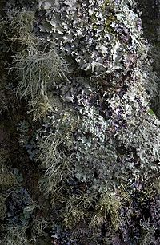
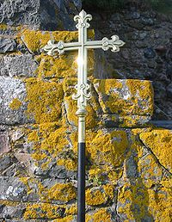
Lichen – mutual relation b/w fungus and algae
Pioneer species
Known to make soil
Other benefits of fungi
Ants can use to break down cellulose
Helps cows digest
Moldy cheeses (blue cheese)
Return nutrients to soil.
Some produce antibodies!! (penecillin)

Slide 13
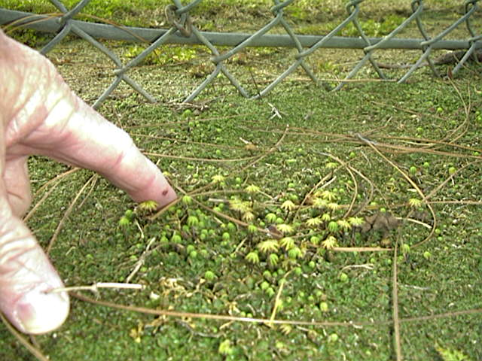

Slide 14
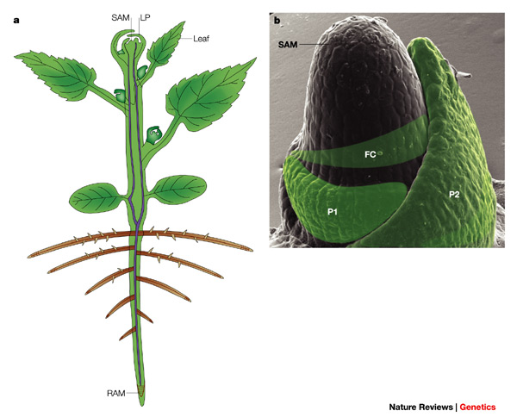
Getting resources
Apical meristem – growth producing regions
Vascular tissue – veins
Xylem – water, mineral from roots
Layers of dead and living cells
Phloem – takes sugars to plant
Layers of living cells

Slide 15
