Slide 1
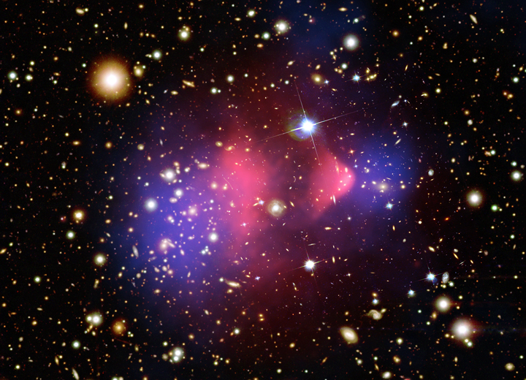
Notes Chapter 15 and 16
Classification of Matter and Solids Liquids and Gases

Slide 2
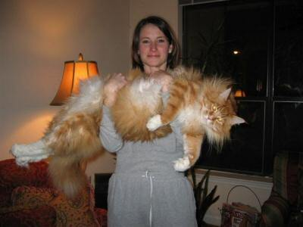
15.1 Comp. of Matter
WYNTK:
What is a substance vs. a Mixture?
ID elements and compounds
What is the difference btw solutions, colloids and suspensions

Slide 3
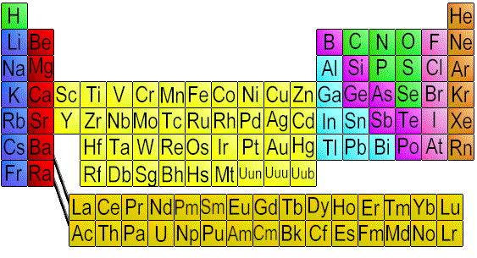
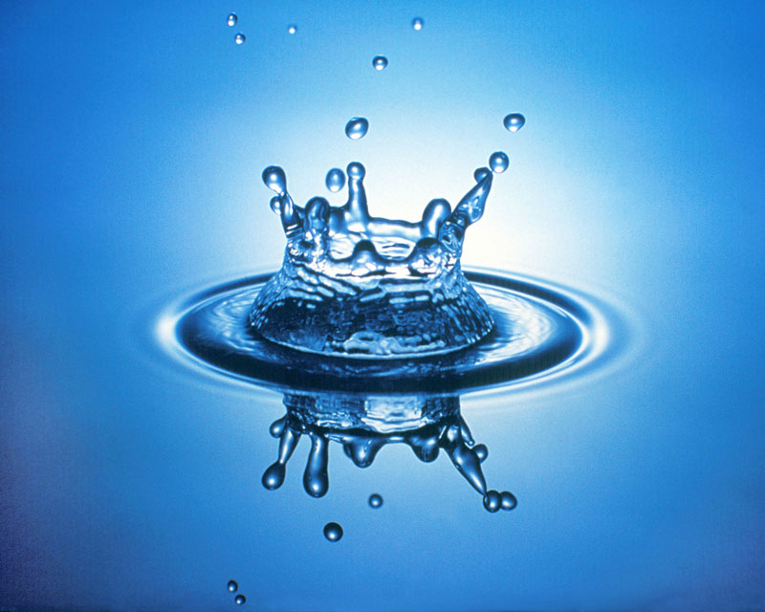
Substances – either an element or compound 1. Element – all atoms in a sample of matter are alike
- start w/ uppercase
-all on periodic table
114
2. Compound – mat. That are made form 2 or more atoms.
- ratios stay same
- H₂O, CO₂, HCl

Slide 4
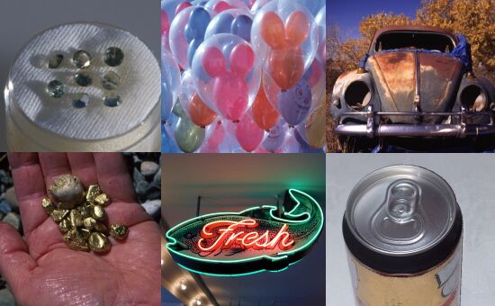

Slide 5
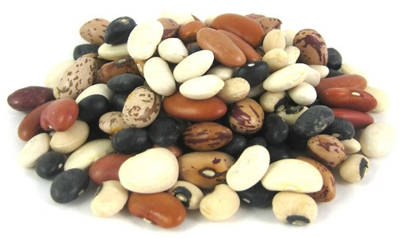
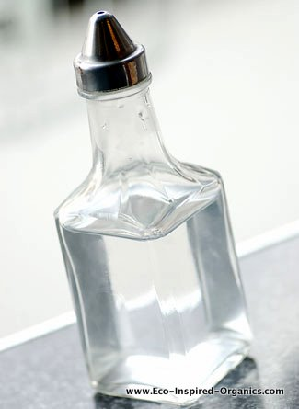
B. Mixtures – mat. Made up of 2 or more substances
1. Heterogeneous – type of mix. Where diff. materials can be seen
- ex: granite, bean soup
2. Homogeneous – (solution) type of mix in which 2 or more sub. are uniformly spread out.
- can’t see with a micro
- particles don’t settle
-ex: kool-aid, vinegar, gasoline

Slide 6
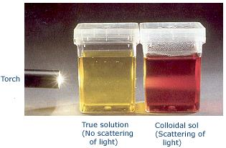
3. Colloids – (both)
- don’t settle
- large particles
- Tyndall effect – scattering of light
- usually opaque
- ex: fog, smog, gelatin, milk
4. Suspensions – (both)
- liquid in which visible particles settle
- mud puddle, Italian dressing

Slide 7
B. Properties of Matter
Physical Property – color, shape, magnetism, density, melting point, boiling point
2. Chemical property – tells us if it will under go a certain chemical change
-warning labels, flammable, combustible

Slide 8
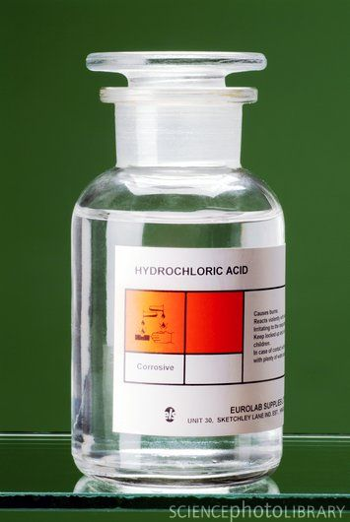
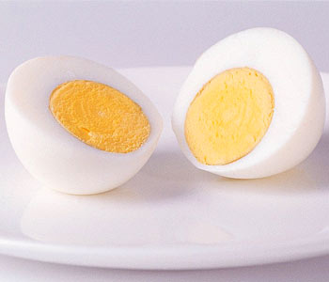
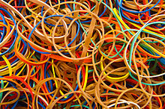

Slide 9
3. Physical Change – size, shape, state of matter
- freezes, boils, cut
4. Chemical Change – change into a new substance
Foaming, smelling, exploding, producing heat, rust

Slide 10
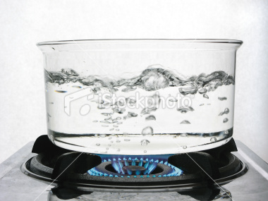
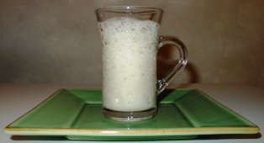
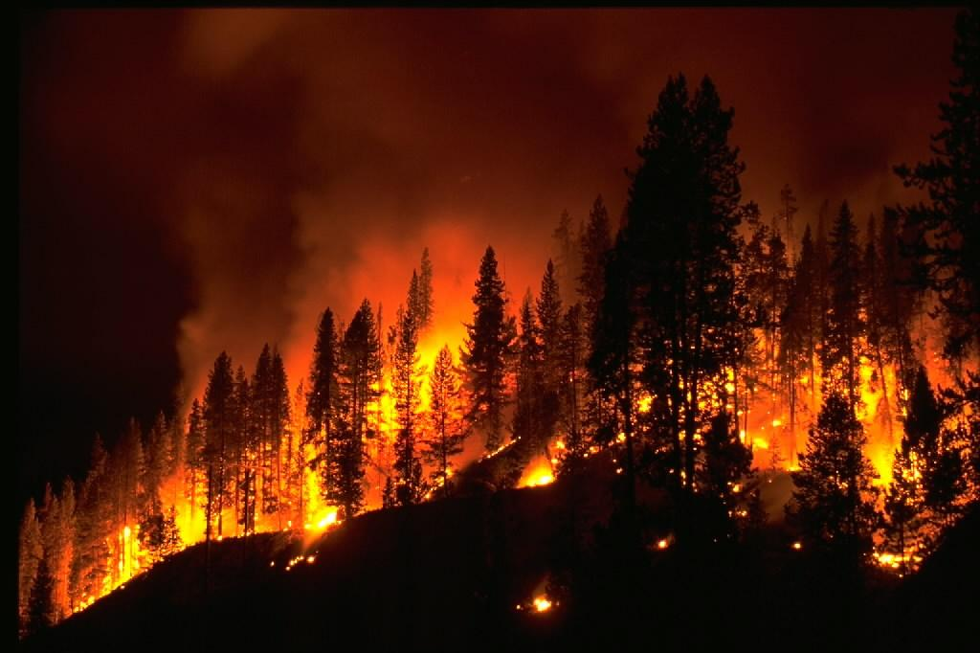
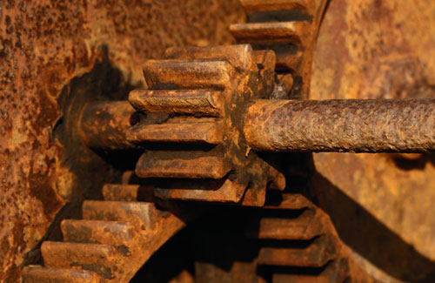

Slide 11
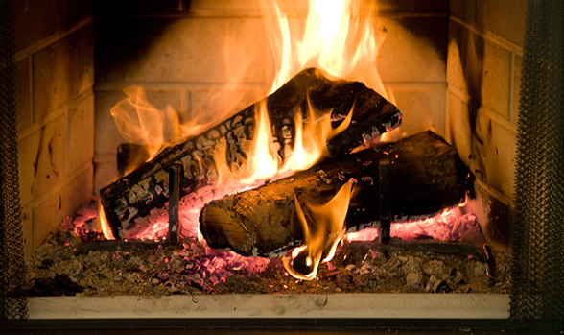
5. Law of Conservation of Mass
Matter is neither created or destroyed during a chemical change.
What ever there is to start off something, it has to equal the amount at the end…..

Slide 12
Bellwork Questions
Which kind of property indicates whether a substance can undergo a certain chemical change?
Which law states that matter can be neither created not destroyed during a chemical change?
The mass of a substance remaining after a chemical change ______, the mass of the substance present before the change.

Slide 13
Classify each of the following as a chemical or physical change:
Photosynthesis
Grinding meat into hamburger
Drying clothes on a clothes line
Burning charcoal
Digestion of food

Slide 14
Classify each of the following as a chemical or a physical property:
Has a high melting point
Reacts with air
Has a sweet odor
Breaks easily
Fizzes when vinegar is added

Slide 15
Which kind of property can be dtermined w/o changing the id of a material?
A change in size, shape, or state of matter is called a _______ change.
A change of one substance into a different substance is a ______ change
Rusting is a chemical change b/c iron and O2 combine to form a new _________.

Slide 16
Classify each of the following as a hetero mixture, homo mixture, element, compound
Air
Table salt
Apple
Silver
Hot tea
Bowl or cake mix
copper

