Slide 1
Atomic Structure and the Periodic Table

Slide 2
WYKTK….
ID names and symbols of common elements
ID quarks as subatomic particles
Describe current model of atom
Explain how electrons are arranges in an atom

Slide 3
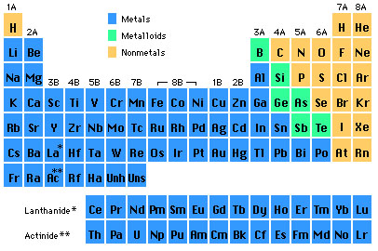
Chemical Symbol

Slide 4
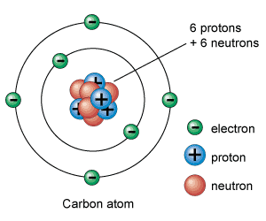

Slide 5
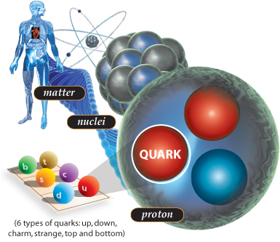

Slide 6
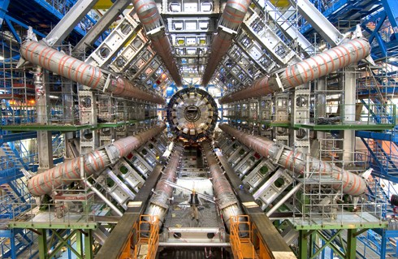
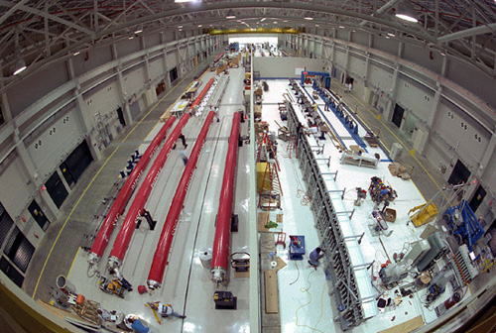

Slide 7
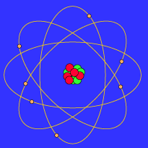
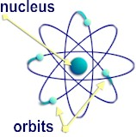

Slide 8
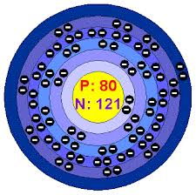
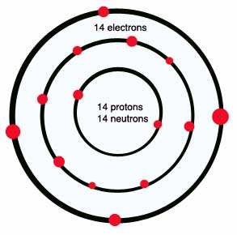

Slide 9
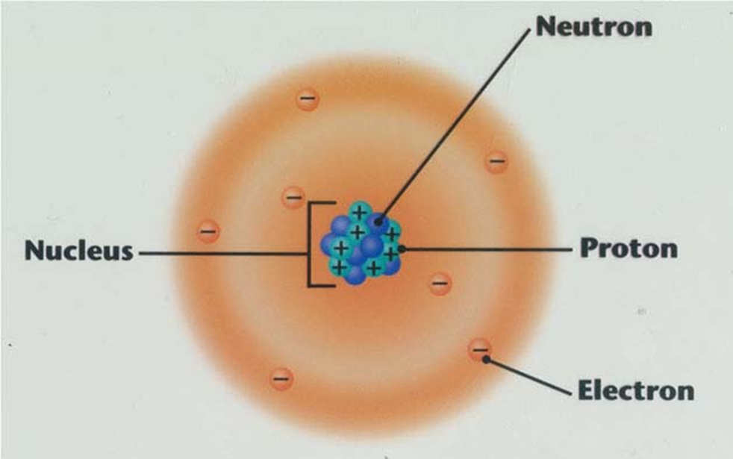
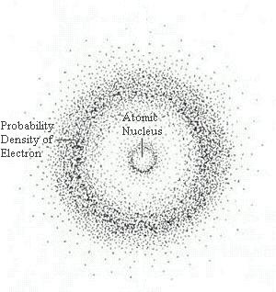

Slide 10
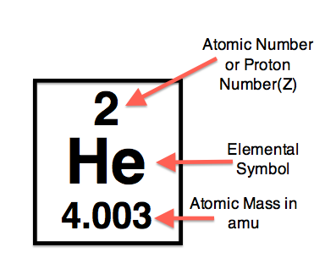

Slide 11
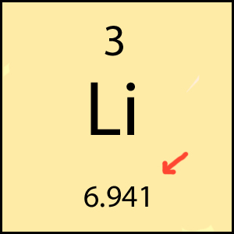

Slide 12
Calculations
P = e
P + n = Mass
The mass can change because number of neutron can fluctuate
Mass – P = neutrons

Slide 13
Isotopes and Ions
Protons NEVER CHANGE! If they change the element changes!!!
BUT……neutrons and electrons can change
Isotope – varying amt of neutrons – why average mass
Ion – varying electrons - Charged particle

Slide 14
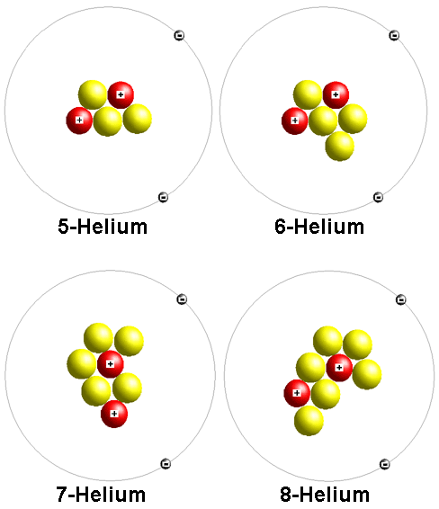

Slide 15
Isotopes
N-14 and N-16
Which one is normal?
What does the 14 and 16 represent?
How can I determine the number of protons, neutrons and electrons?

Slide 16
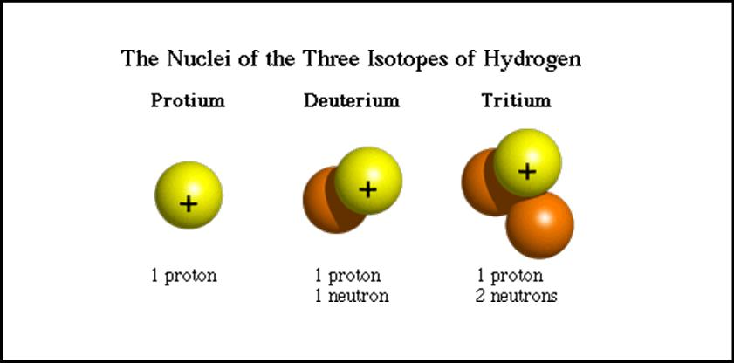

Slide 17
Energy levels of Electrons
Energy Level in Atoms | Maximum Number of Electrons
1 | 2
2 | 8
3 | 18
4 | 32
5 | 32
6 | 18
7 | 8

Slide 18
How to draw an atom Correctly!
Find the element
Determine # of p, n, e
Draw symbol and #p and n in the nucleus.
Draw energy levels (# of rows)
Put #e in outer shell (#of columns)
Fil in other electrons

Slide 19
Trends of the periodic table

