Slide 1
senses

Slide 2
Senses
Detect and respond to physical and chemical stimuli
Vision
Hearing
Smell and Taste
Touch, Temp, and Pain

Slide 3
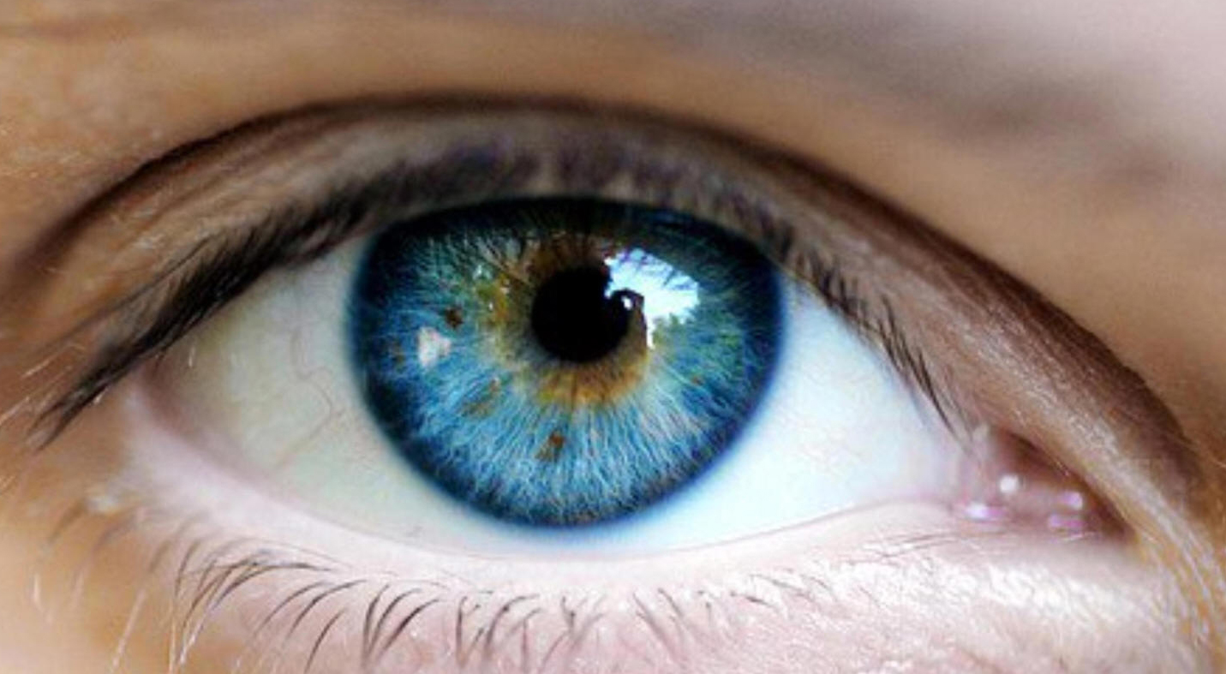

Slide 4
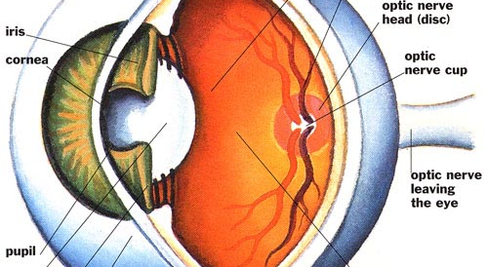

Slide 5
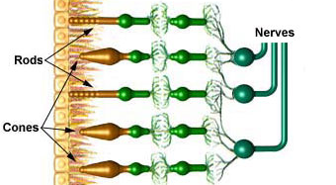

Slide 6
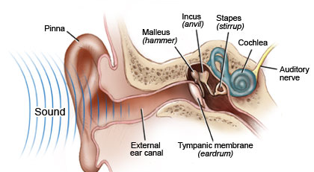

Slide 7
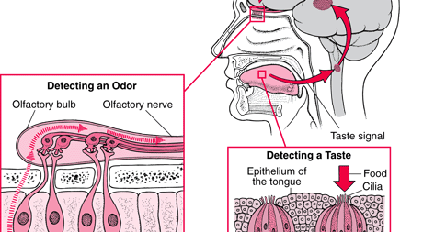

Slide 8
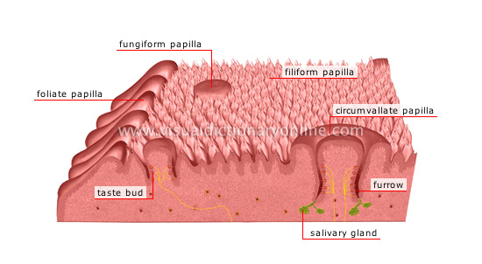

Slide 9
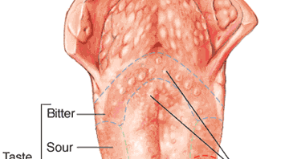

Slide 10
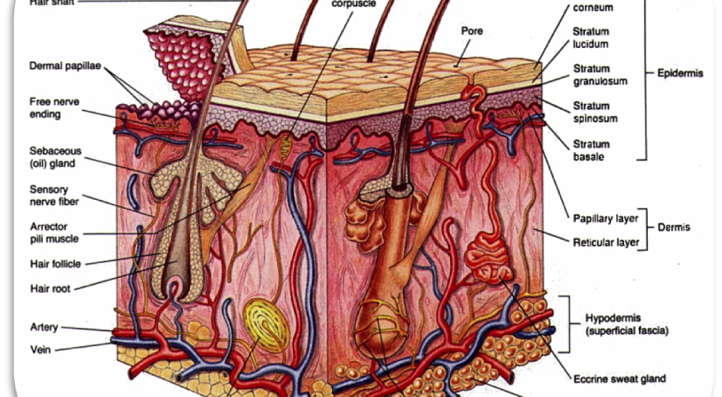

Slide 11


Slide 12
Diseases within Nervous System
Multiple Sclerosis
Parkinson's Disease
Schizophrenia
Bipolar
Alzheimer's
Major Depression
ALS

