Slide 1
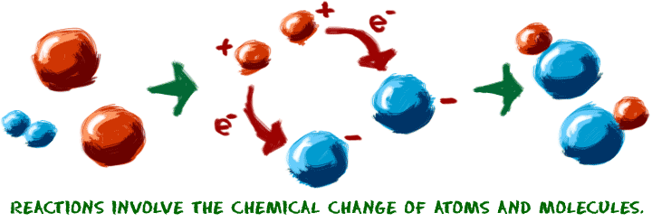
Chemical Reactions & Enzymes
Standard B-2: The student will demonstrate an understanding of the structure and function of cells and their organelles.

Slide 2
Key Concepts
Biochemical Reactions
Activation Energy
pH
Catalyst - Enzymes

Slide 3
Objectives
Describe how bonds break and reform during chemical reactions.
Explain why chemical reactions release or absorb energy.
Explain the effect of a catalyst on activation energy.
Describe how enzymes regulate chemical reactions.
State that factors such as temperature and pH affect the rates of chemical reactions.

Slide 4
Chemical reaction
Reactant
Product
Bond Energy
Equilibrium
Activation energy
Exothermic
Endothermic
Catalyst
Enzyme
Substrate

Slide 5
Chemical Reactions
Chemical reactions change substances into different ones by breaking and forming chemical bonds.
Reactants are changed during a chemical reaction
Products are made by a chemical reaction.

Slide 6
Chemical Reactions
Bond energy is the amount of energy that breaks a bond.
Energy is added to break bonds.
Energy is released when bonds form.
A reaction is at equilibrium when reactants and products form at the same rate.
CO₂ + H₂O → H₂CO₃

Slide 7
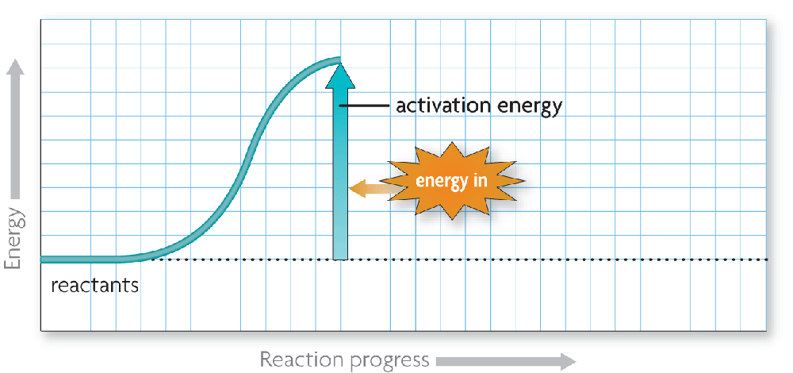
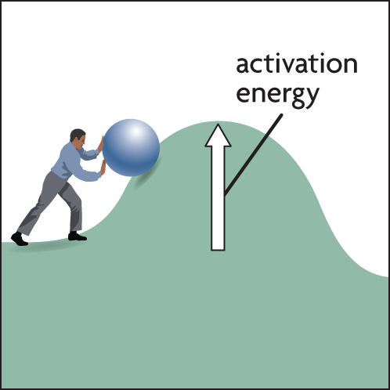
Chemical Reactions
Activation energy is the amount of energy that needs to be absorbed to start a chemical reaction.

Slide 8
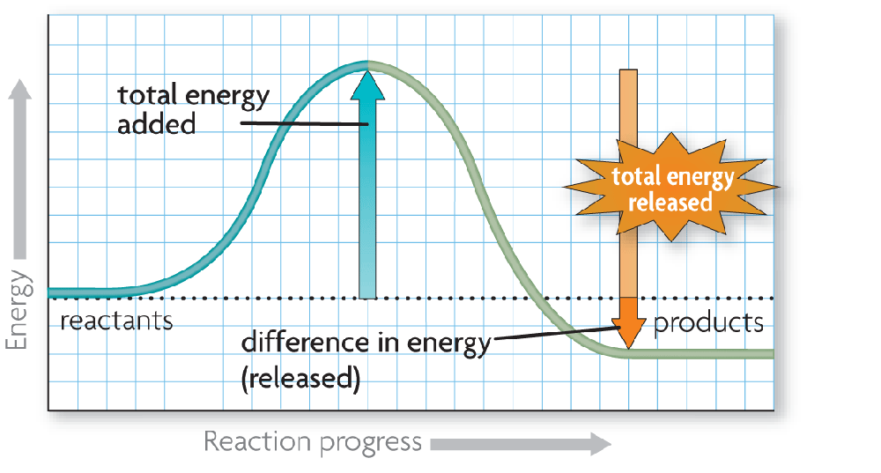
Chemical Reactions
Exothermic reactions release more energy than they absorb.
Reactants have higher bond energies than products.
Excess energy is released by the reaction.

Slide 9
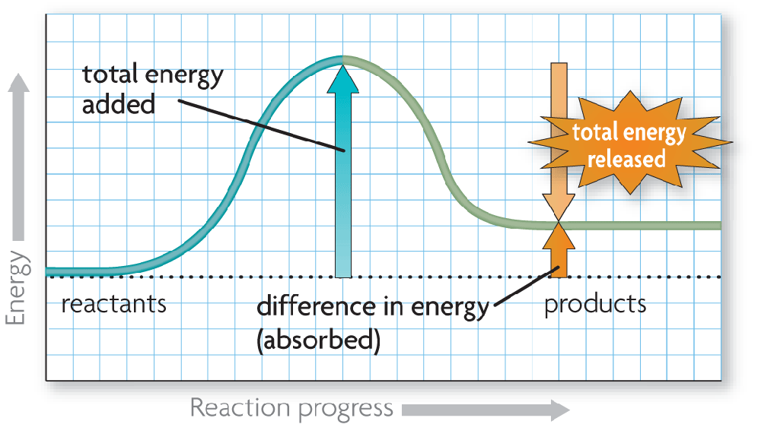
Chemical Reactions
Endothermic reactions absorb more energy than they release.
Reactants have lower bond energies than products.
Energy is absorbed by the reaction to make up the difference.

Slide 10
Effects on Chemical Reactions
Many things can interfere with the rate of a chemical reaction
Temperature
pH
Enzymes

Slide 11
Effects on Chemical Reactions
TEMPERATURE
Chemical reactions require energy to get reactants to collide with one another. Sometimes that energy is in the form of heat. Changes in temperature (gaining or losing heat energy) can affect a chemical reaction.

Slide 12
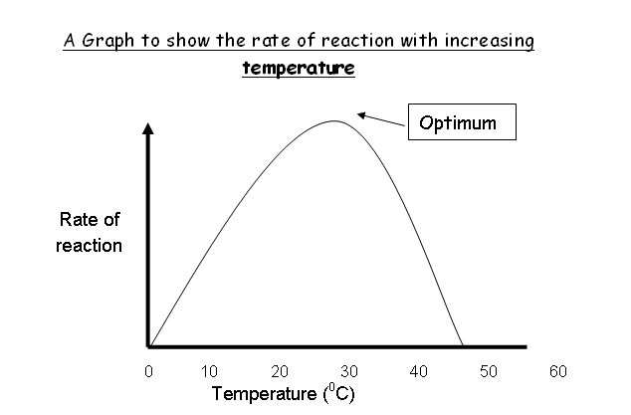

Slide 13
Effects on Chemical Reactions
pH
pH (a measure of the acidity of a solution) in most organisms needs to be kept within a very narrow range. Buffers within an organism are used to regulate pH so that pH homeostasis can be maintained. A small change in pH can disrupt cellular processes, including chemical reactions.

Slide 14
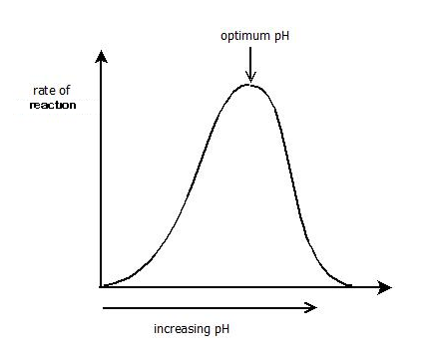

Slide 15
Effects on Chemical Reactions
Enzymes
A catalyst is a substance that changes the rate of a chemical reaction or allows a chemical reaction to occur (activate) at a lower than normal temperature. Enzymes are biological catalysts found in living organisms that lower activation energy needed for a chemical reaction to occur.

Slide 16
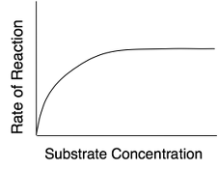

Slide 17
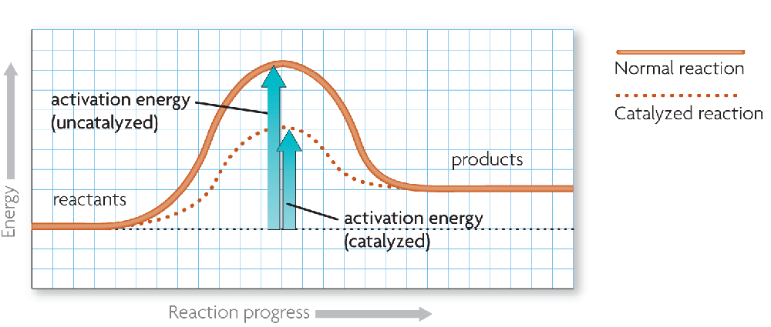
Enzymes
A catalyst lowers activation energy.
Catalysts are substances that speed up chemical reactions.
decrease activation energy
increase reaction rate

Slide 18
Enzymes
Enzymes allow chemical reactions to occur under tightly controlled conditions.
Enzymes are catalysts in living things.
Enzymes are needed for almost all processes.
Most enzymes are proteins.

Slide 19
Enzymes
Disruptions in homeostasis can prevent enzymes from functioning.
Enzymes function best in a small range of conditions.
Changes in temperature and pH can break hydrogen bonds.
An enzyme’s function depends on its structure.

Slide 20
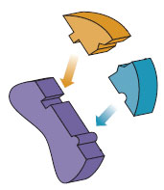
Enzymes
An enzyme’s structure allows only certain reactants to bind to the enzyme.
substrates
active site
substrates (reactants)
enzyme
Substrates bind to an enzyme at certain places called active sites.

Slide 21
Enzymes
The lock-and-key model helps illustrate how enzymes function.
substrates brought together
bonds in substrates weakened
Substrates bind to an enzyme at certain places called active sites.
The enzyme brings substrates together and weakens their bonds.
The catalyzed reaction forms a product that is released from the enzyme.

