Slide 1
The Cell Cycle
B-2.6: Summarize the characteristics of the cell cycle: interphase (G₁, S, G₂); the phases of mitosis (prophase, metaphase, anaphase, telophase); and plant and animal cytokinesis.

Slide 2
Key Concepts
Cell Cycle
Interphase
Mitosis
Cytokinesis

Slide 3
It is essential for you to know…
The cell cycle is a repeated pattern of growth and division that occurs in eukaryotic cells.
The cell cycle has three phases: Interphase, Mitosis, and Cytokinesis

Slide 4
Objectives
Describe how cell division solves the problems of cell growth.
Describe the structure of a chromosome in both a prokaryote and a eukaryote.
Name and Describe the main events of the cell cycle.
Compare cell division in a prokaryote and a eukaryote.

Slide 5
Vocabulary
Cell cycle
Mitosis
Cytokinesis
Chromosome
Histone
Chromatin
Chromatid
Centromere
Telomere
Prophase
Metaphase
Anaphase
Telophase

Slide 6
Why do cells not grow forever?
Living things grow by producing more cells.
Cells do not grow indefinitely:
DNA overload
Too many demands on the DNA
Problems exchanging materials
Surface area determines the rate at which food, oxygen, and water enter a cell and wastes leave a cell.
The rate at which food and oxygen are used up and wastes produced is determined by the volume of the cell.

Slide 7
The Solution
Cells divide rather than grow indefinitely.
Cells divide to become 2 “daughter” cells before it becomes too large.
This is called cell division.
1st the cell replicates, or copies, its DNA
Each daughter cell gets a complete set of DNA
Each daughter cell has an increased ratio of SA to Volume for efficient exchange of materials.

Slide 8
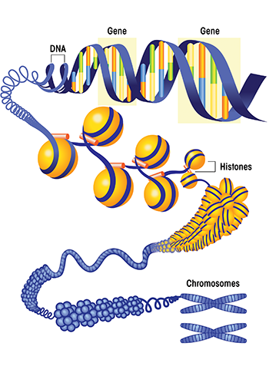
Chromosomes
Genetic info is carried by chromosomes.
Chromosomes are made up of DNA and protein.
Histones are the proteins that help maintain the shape of the chromosome.

Slide 9
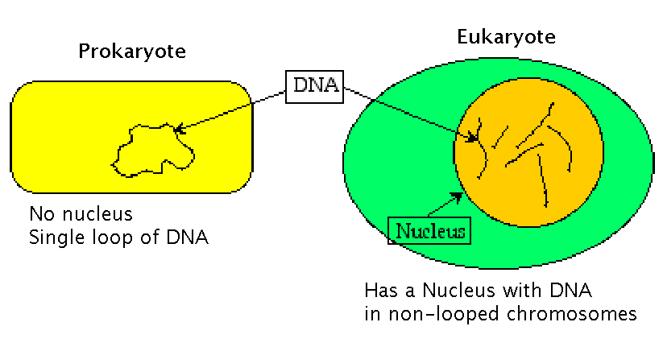
Chromosomes
Chromosomes are usually only visible during cell division. They condense into compact, visible structures.
NOT present in prokaryotes – no nucleus nor as much DNA needed.

Slide 10
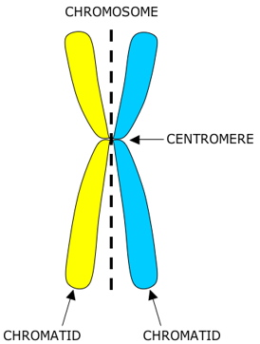
Chromosomes
Before cell division, each chromosome is replicated (copies itself).
Once they replicate and condense, they become sister chromatids and are attached to one another in the center, called the centromere.

Slide 11
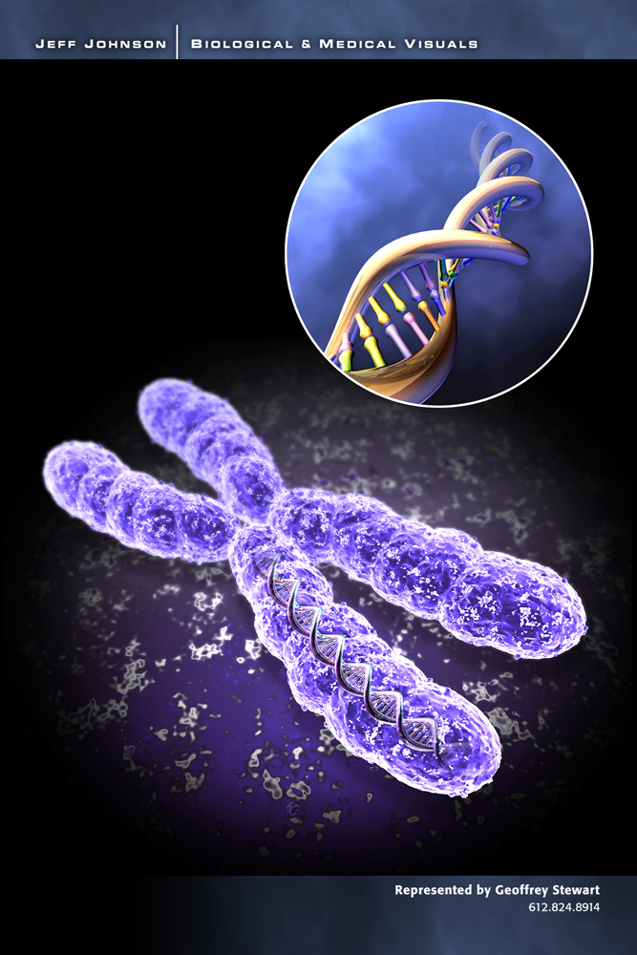
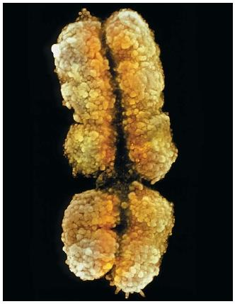
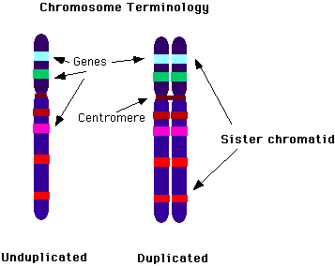

Slide 12
Chromosomes
Each species has a characteristic number of chromosomes found in each cell.
Humans have 46 whereas flys have 8.
Human and animal chromosomes are categorized as either sex chromosomes or autosomes.
A karyotype is a “picture” of all the chromosomes of an organisms, with their homologous pairs.

Slide 13
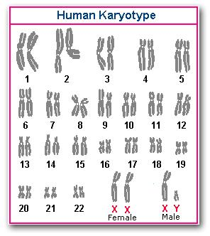

Slide 14
Chromosomes
Sex Chromosomes
Determine the sex of an organism
In humans, sex chromosomes are either “X” or “Y”.
XY is for males
XX is for female
Only 2 of the human chromosomes
Autosomes
Any chromosome that is NOT a sex chromosome
Consists of the other 44 chromosomes
Each organism has 2 copies of autosomes
One from mom, one from dad
Are considered homologous chromosomes

Slide 15
Chromosomes
Diploid
2N = 46 (humans)
Each cell in the human body, except for sperm and egg cells, are diploid
In Somatic (Body) Cells
Haploid
N = 23 (humans)
Sperm and Egg cells only
Gametes or Sex Cells

Slide 16
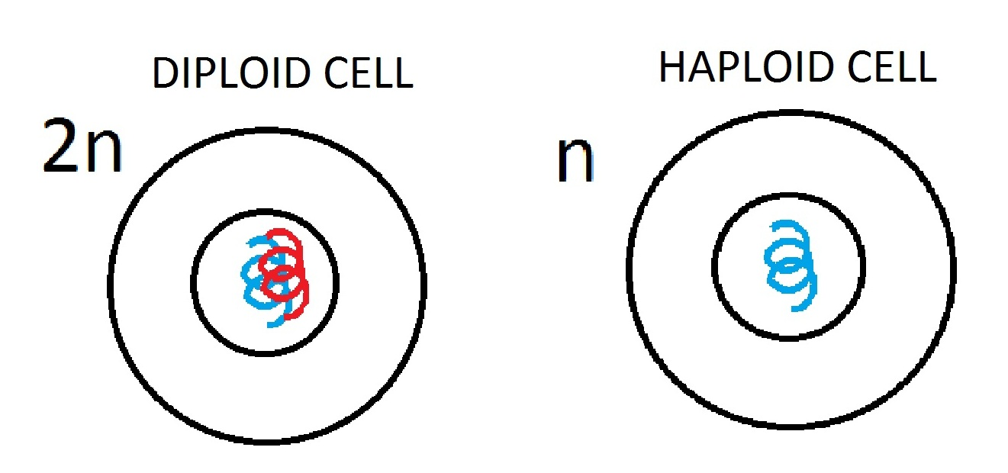
Diploid vs. Haploid

Slide 17
The Cell Cycle and Mitosis
The cell cycle is the series of events that eukaryotic cells go through as they divide and grow.
Mitosis (body cells) or meiosis (sex cells)
These events can be divided into 2 main parts:
Interphase is the period between cell divisions when the cell grows and replicates DNA and Organelles. Consists of G₁, S, and G₂.
Mitotic Phase is when the cell is actually dividing its chromosomes and cytoplasm. Consists of Mitosis and Cytokinesis.

Slide 18
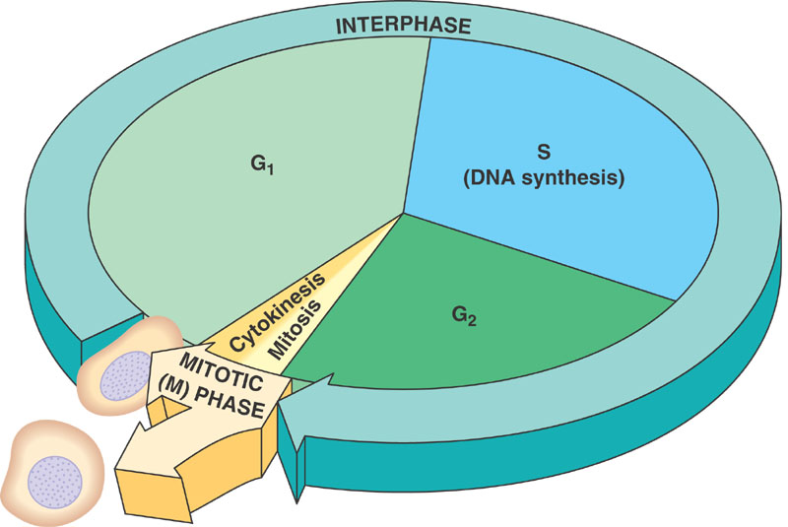

Slide 19
Interphase
Interphase can be long, but the actual cell division is quick.
Interphase: G₁, S, and G₂
G₁ phase: cell does most of its growing in size and synthesizes (makes) new proteins
S phase: chromosomes are replicated, DNA
synthesis occurs, key proteins are
synthesized, and cell is committed to enter
mitosis
G₂ phase: after DNA replication, usually the shortest of the three parts, cell is now ready to divide

Slide 20
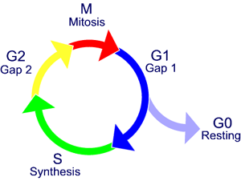
Interphase
Sometimes a cell will exit the cell cycle, usually from G₁ phase and enter what is known as G₀. In this phase, cells are alive and active, but will not continue on to eventually divide. Cells like heart muscle, eye and brain. If damaged, they cannot be replaced.

Slide 21
Mitotic Phase (M-Phase)
Mitosis and Cytokinesis
4 phases of mitosis:
Prophase
Metaphase
Anaphase
Telophase
May last a few minutes or several days.
Results in GENETICALLY IDENTICAL cells.
NOT in prokaryotes (no nucleus)

Slide 22
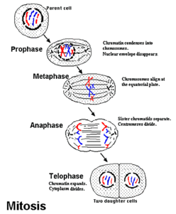

Slide 23
Mitosis
Prophase
First and longest phase of mitosis
Takes 50-60% of the time
Chromosomes become visible
Centrioles separate to opposite sides of nucleus.
Centrioles lie in centrosome and help organize the spindle which helps separate the chromosomes.

Slide 25
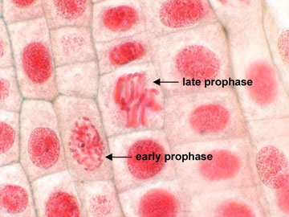

Slide 26
Mitosis
Metaphase
2nd phase of mitosis
Chromosomes line up across the center of the cell.
Microtubules connect centromeres to poles of the spindle fibers.

Slide 28
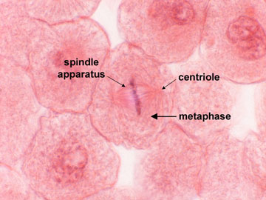

Slide 29
Mitosis
Anaphase
3rd phase of mitosis
Centromeres separate allowing sister chromatids to separate and become individual chromosomes.
Chromosomes move apart until they have separated into 2 groups near the poles of the spindle.
Ends when the chromosomes stop moving.

Slide 31
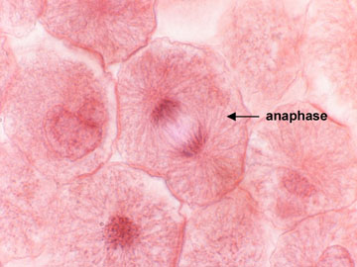

Slide 32
Mitosis
Telophase
4th phase of mitosis
Chromosomes disperse into a tangle of dense material.
Nuclear envelope reforms around each cluster of chromosomes.
Spindle begins to break apart.
Nucleolus becomes visible in each daughter nucleus.
Mitosis is complete.

Slide 33
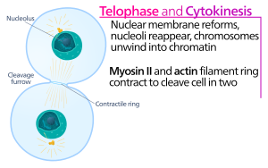

Slide 34
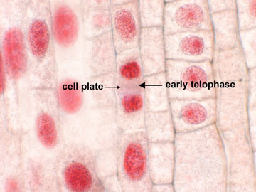

Slide 35
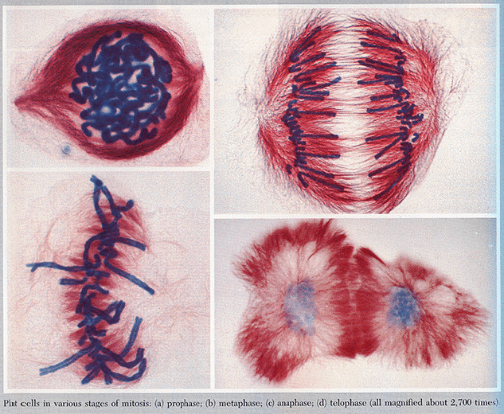

Slide 36
Cytokinesis
In animal cells, the cell membrane is pinched inward, forming a cleavage furrow.
In plants, a cell plate forms midway between the nuclei which gradually develops into a cell wall.

Slide 37
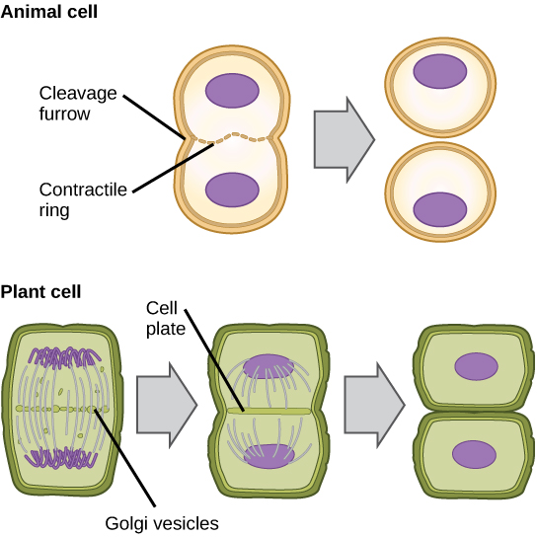

Slide 38
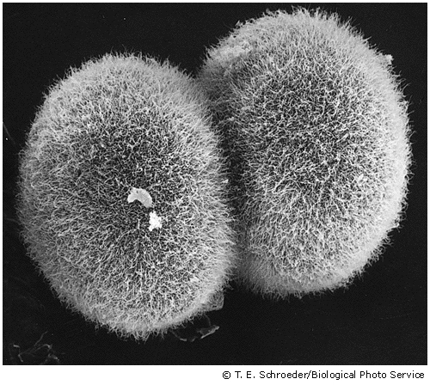

Slide 40
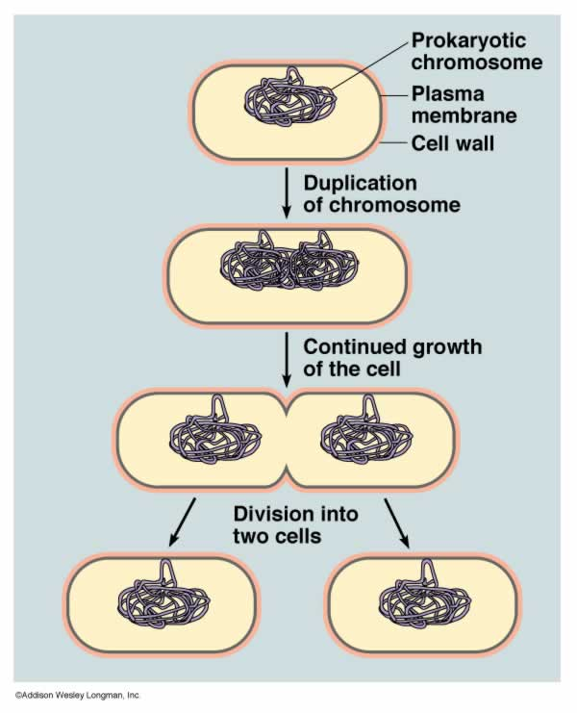
Cell Division in Prokaryotes
Binary fission
The prokaryotic cells DNA is copied and the cell splits into two cells.
The “offspring” is a genetic copy of the “parent”.

Slide 41
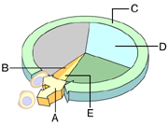

Slide 42
