Slide 1
Motion and speed

Slide 2
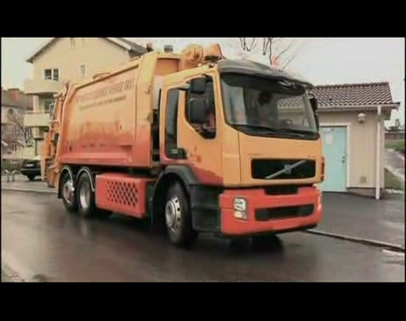
Describing Motion
Motion – when an object changes its position relative to a reference point.
Distance – how far an object has moved
Displacement – distance and direction of an objects change for position from a starting point
Pg 38 and 39

Slide 3
B. Speed- distance an object travelers per unit of time
1. Rate – any change over time
2. Speed = distance /time
v = d/t v = meters/second
3. Speed that doesn’t change over time – constant (cruise control)
4. Average speed – speed of motion when speed is changing. (avg. speed to Columbia)
5. Instantaneous speed –speed any given point in time. (what a cop would catch you at)
Pg. 40

Slide 4
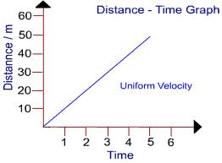
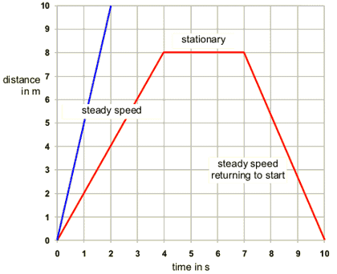
C. A distance-time graph displays motion of an object over time (swim ex pg 43)
1. Distance on y axis
2. Time on x axis

Slide 5
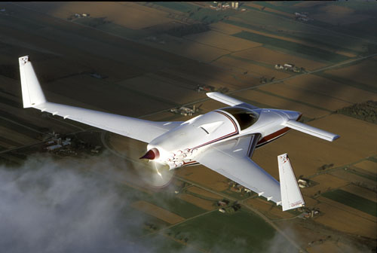
D- velocity – speed and direction (v)
Same formula as speed

Slide 6
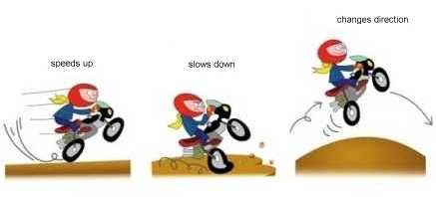
Acceleration
Acceleration – change in velocity’s rate (a)
Positive acc –speed is increasing
Negative acc. – speed is decreasing
When an object changes speed or direction, it is accelerating.

Slide 7
B. Calculating acceleration
Acceleration = change in velocity/ time
a = vf – vi v
t t

Slide 8
Acceleration examples
Find the acceleration of a train that goes from 32 m/s to 160 m/s in 15 sec.
A car on a freeway ramp has a velocity of 14 m/s to 36 m/s in 12 sec. What is the acceleration?

Slide 9
Motion and forces pg 52
Force -a push or pull that one body applies to another
Can cause a object motion to change
When two or more forces combine at the same time, the create a net force.
Balanced forces are equal in size and opposite in direction.
Unbalanced forces are unequal in size and or are not in the same direction.

Slide 10
Inertia and Mass
Inertia –an objects resistance to change in motion
Greater mass, greater the inertia
Newton’s first law of motion – an object moving at a constant velocity will stay in motion until an equal or opposite force acts on it. An object will stay at rest until a net force acts on it.
-auto crashes

Slide 11
How would a seat belt help with inertia?

