Slide 1
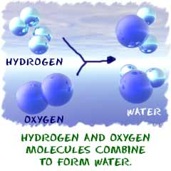
Chemical Reactions
What is a chemical
reaction?

Slide 2
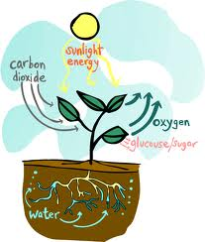
Chem Rxns – a rxn in which 1or more substances are changed to new substances
RAP
Reactant –what goes in
Product – what comes out
6CO₂ + 6H₂O → C₆H₁₂O₆ + 6O₂

Slide 3
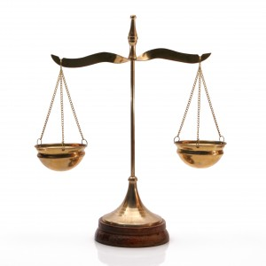
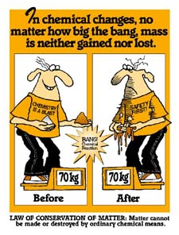
Conservation of Mass
Matter is not created or destroyed, but it is conserved.
Burning of a log
What goes in must come out.

Slide 4
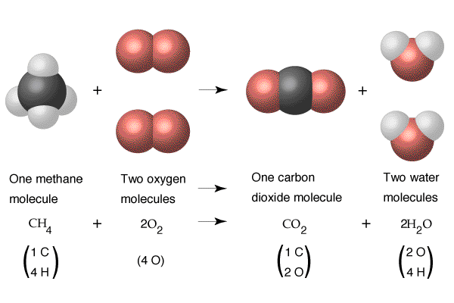

Slide 5
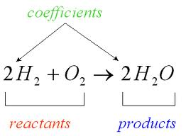
Describing chemical rxns
Coefficient- represent the relative amt of substances taking part in a rxn.

Slide 6
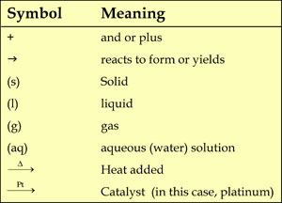
C₃H₈ (g) + 5 O₂ (g) 3 CO₂ (g) + 4 H₂O (g)
Ca₃(PO₄)₂ (s) + H₂SO₄ (aq) CaSO₄ (s) + H₃PO₄ (aq)

Slide 7
Pb(NO₃)(aq) + 2KI(aq) →PbI₂(cr) + 2KNO₃(aq)
PbI₂ is in what state?
2KI si made up of how many atoms?
List all the products.
List all the reactants.

Slide 8
Write out the equation
Mg metal will react with HCl, to produce magnesium chloride, and diatomic hydrogen.

Slide 9
Determine the number of atoms of each element present.
2C₆H ₁₄
5NaCH₃CO₂

Slide 10
http://faculty.sdmiramar.edu/fgarces/zCourse/All_Year/Ch100_OL/aMy_FileLec/04OL_LecNotes_Ch100/06_ChemRxnStoic/601_ChemicalRxn/601_ChemRxn.htm

Slide 11
Chemical Equations
Ag(cr) + H₂S(g)→ Ag₂S(cr) + H₂(g)
How did 1atom of silver become 2?
****** Remember*********
  Matter is never created or destroyed in a rxn.
  Equations must be balanced so it shows a true picture of what takes place in the rxn.

Slide 12
Balanced Chemical Equations
Has the same # of atoms of each element on both sides of the equation.
NEVER change subscripts to balance
Place Coefficients to the left of formula so that there are equal amts.

Slide 13
Steps to Balance Equations
place line in front of compound to show where coeffients will go.
Draw line separating P from R.
ID and count all elements and atoms
Add coefficients until balanced.
  Each time you change one, change all

Slide 14
Types of Chemical Rxns
Synthesis – 2 or more substance combines to form another
  A + B → AB 2H₂ + O₂ → 2H₂O
Decomposition – one sub breaks down into its parts
  AB → A + B 2H₂O → 2H₂ + O₂

Slide 15
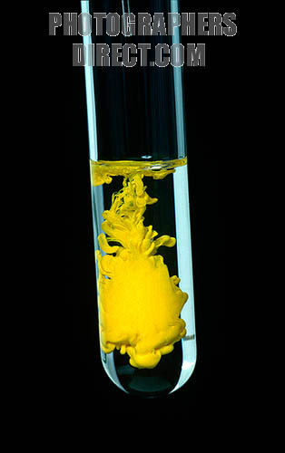
Single displacement – when one element replaces another element in a compound.
A+ BC→ AC + B
Cu + 2AgNO₃ → Cu(NO₃)₂ +2Ag
Double displacement –when the positive ion of one reaction replaces the positive ion of the other to form 2 new compounds
  AB + CD → AD+ CB
  Ba (NO₃)₂ + K₂SO₄ → BaSO₄ + 2KNO₃
Precipitate – DD rxn

Slide 17
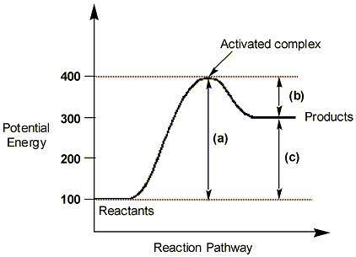

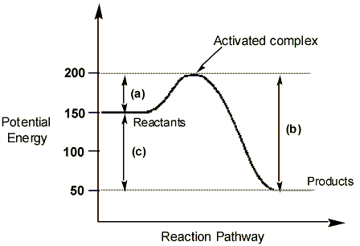
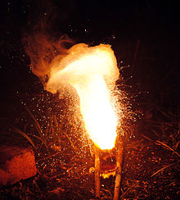
21.4 energy exchanges
All chem. rxns release or absorb energy
Endothermic – absorbs energy, takes energy to break bonds. Gets cooler
Exothermic – releases energy, gets hot, light

Slide 18
Catalyst – speeds up a chemical rxn
  Does not alter actual rxn
  Can occur at lower temp
  Can happen at a raster rate.
Inhibitors –substances added to slow the rate of rxns. Preservatives, citric acids.
  Neither affect the amt of product, just the rate of the product.

